Slide 1
Metal Additive manufacturing – A supply chain perspective
Mathias Sæterbø PhD Fellow UiT The Arctic University of Norway

Slide 2
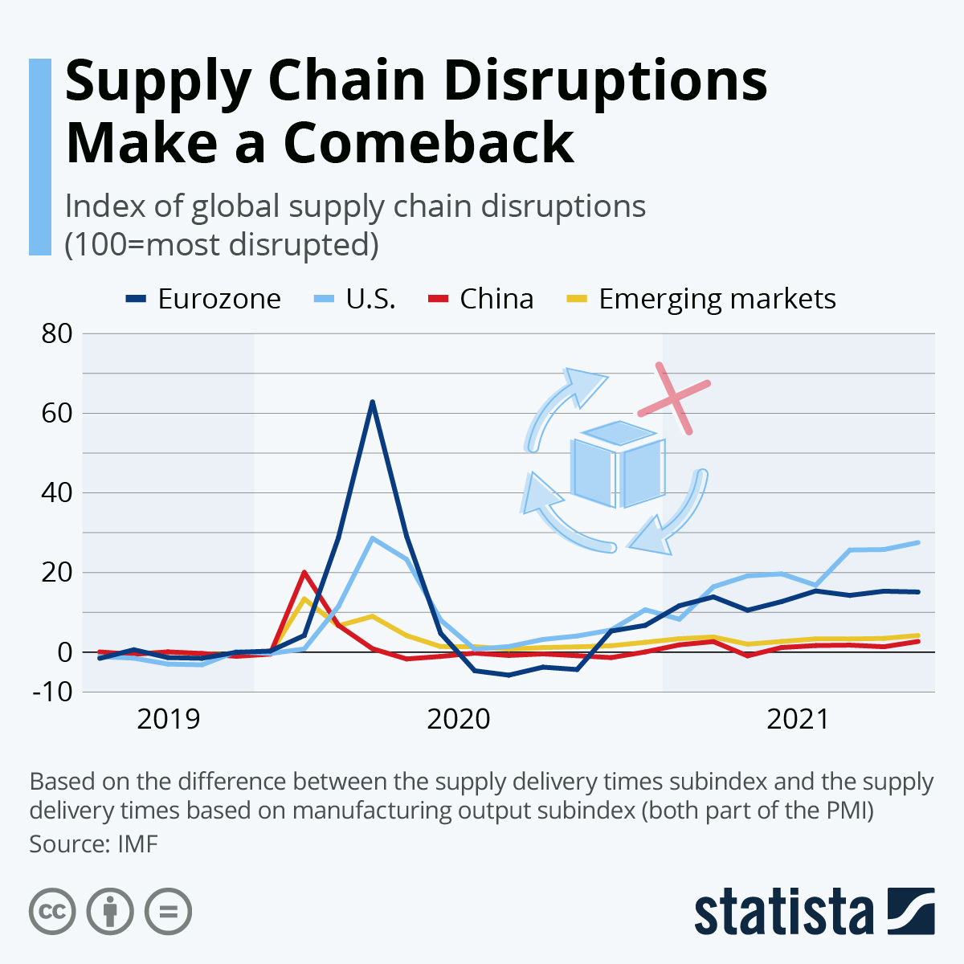
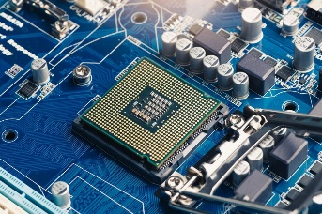
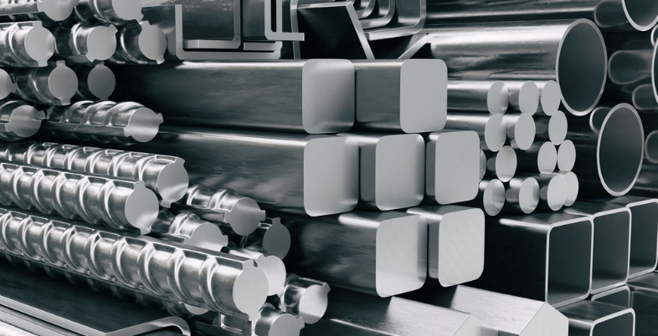
Long term impact of Covid19 (lockdown and restriction)
Labor and material shortages
Geopolitical uncertainty

Slide 3
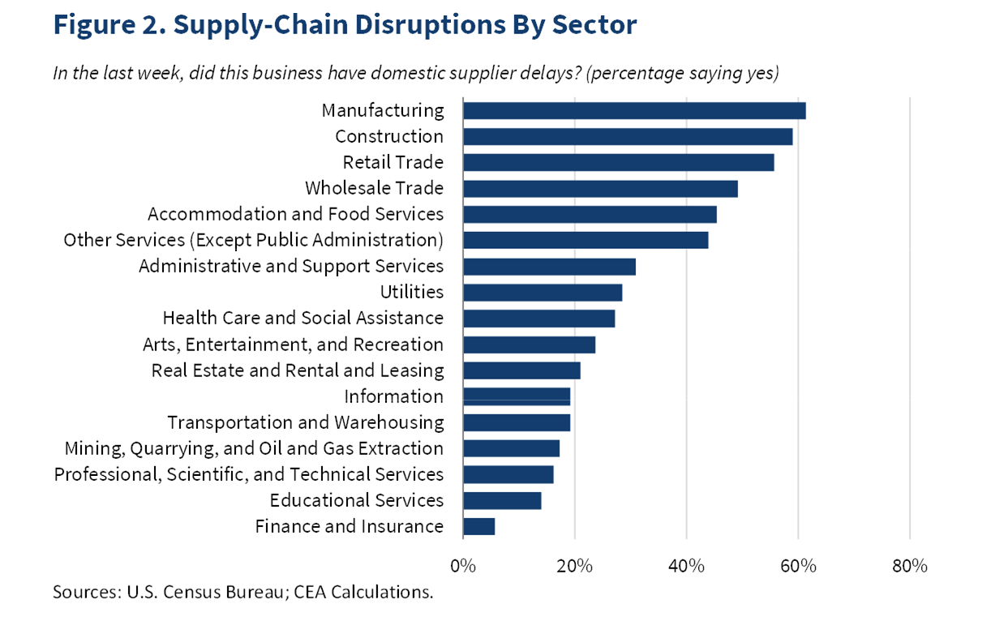
How does Additive Manufacturing fit into all this?

Slide 4
How does Additive Manufacturing fit into all this?

Slide 5
Additive manufacturing
AM is defined by the American Society for Testing and Materials (ISO/ASTM 52900:2021) as a manufacturing process of joining materials to make parts from 3D model data, usually layer upon layer, as opposed to subtractive manufacturing and formative manufacturing methodologies

Slide 6
https://www.3dprintingmedia.network/wp-content/uploads/2019/06/3dpbm-Map-of-Additive-Manufacturing-Technologies-and-Companies-1.svg

Slide 7
How are AM transforming traditional supply chains?
Reduce SC complexity
Decentralized production
On demand manufacturing
Customization

Slide 8
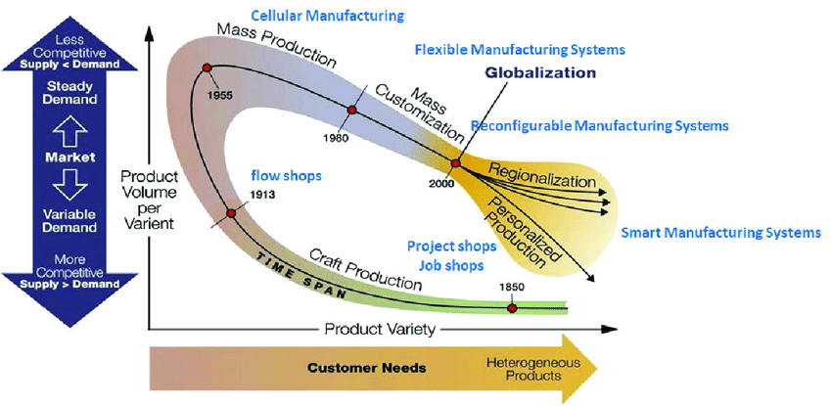
Customization
Customers have always wanted more. More choices, more options, more extras, and more features. The current challenge we face is the speed at which they want it delivered. They want everything right now, AND… they don’t want to pay more for it.
Craft production
Mass production
Flexible production
Individualized
Low variety
High variety
Mass customization
High variety
Low cost
High cost
Low cost
High cost
Source: https://www.researchgate.net/publication/353468809_Human_in_the_Loop_Industry_40_Technologies_and_Scenarios_for_Worker_Mediation_of_Automated_Manufacturing/figures?lo=1

Slide 9
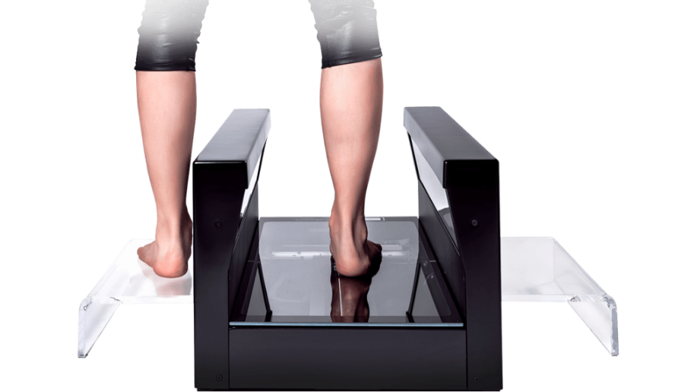
Customization
How do AM fit in customization?
AM is a strong enabler of product customization and can have remarkable impacts on production and distribution
AM could better serve customers needs via mass customization, manufacturing to customer specifications in smaller scale (as opposed to producing goods of the same type in bulk with traditional manufacturing)
By involving clients in the design and production stages and tailoring individualized offers to each customer, AM has the potential to reduce costs and increase profits. As a result, supply chain can quickly react to changes in the marketplace
Examples
Dental and medical field. Aligner orthodontics such as Invisalign can now be 3D printed at the dentist’s office instead of being manufactured off-site and mailed.
Superfeet uses HP’s FitStation machines to scan feet to 3D print custom orthotics that can be sent to customers in about a week, cutting down on time and cost of acquiring inserts.
Source: Invisalign
Source: rs scan

Slide 10
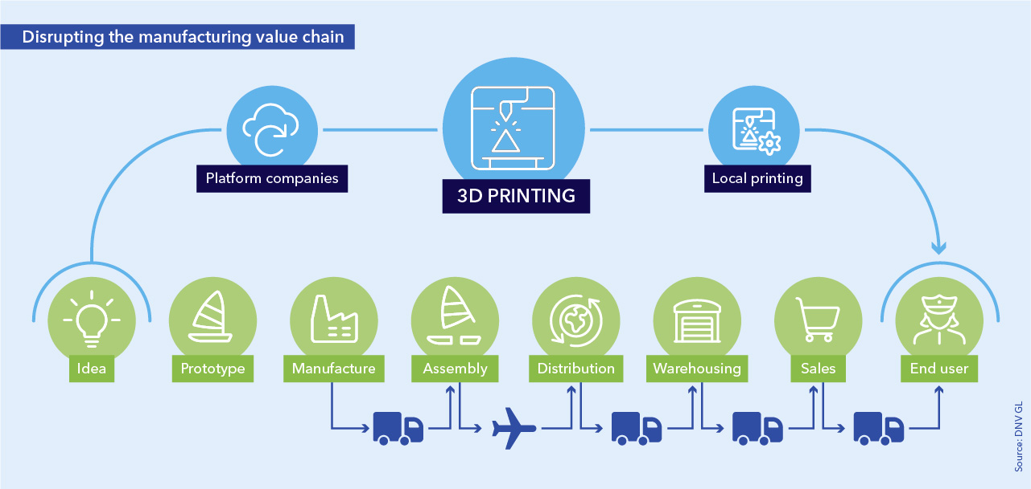
Reduce SC Complexity
AM has the potential to reduce SC complexity and improve time-to-market in several ways:
Consoldation of components into a single product
Removal of assembly and pre-assemby steps
Potential to reduce the supplier base of the components
Inventory management would be less complicated
Consoldation of components into a single product leads to a reduction in finished goods inventory level and complexity
The need for production tooling, sub-assemblies, components, fixtures are reduced with additive manufacturing.
Reduced inventory obsolescence risk because of production in smaller lot sizes.

Slide 11
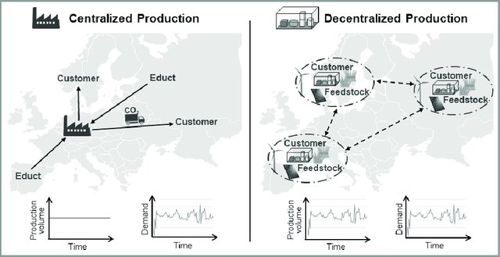
Decentralized Production
Companies with centralized manufacturing have a single facility to produce and distribute their products or a central factory with multiple distribution points in their supply chain.
A decentralized manufacturing company has multiple facilities that cover large areas, allowing products to be manufactured and distributed close to customers.
Advantage
Single factory can dramatically reduce per unit production cost by using the same equipment to produce different products (Economies of scale)
Disadvantage
Less flexible
High cost of customization
Labour cost can also be a disadvantage if a company maintains its central plant in a region or country where wages are rising
Advantage
Highly flexible
The production network can react to dynamic supply and demand development
Close vicinity to customer
Less transportation and therefore less carbon emission.
Disadvantage
Multiple sites require a larger investment or more capital to set up
Maintaining organization wide consistency in products and processes is a challenge
Source: Modular Production with Bio-Based Resources in a Decentral Production Network. Marco Finkbeiner

Slide 12
Decentralized Production
How do AM fit decentralization?
The flexibility and customization that AM brings to manufacturing will make it easy for companies to maintain smaller, decentralized factories in different parts of the world
The transportation cost of global logistics network can be reduced by enabling companies to station local manufacturing centers closer to markets resulting in reducing the length of the supply chain.
Instead of shipping large physical parts, the designs (CAD files) can be transferred digitally and produced locally.
Localized production means less transportation of parts and finished goods → Less carbon emmision
Transportation needs focus on raw materials, where demand is more aggregated and transportable. The printer firms suppliers will largely deal in materials, for which demand is easier to predict than the demand for today’s frequently specialized components.
Localization of production enables fast delivery upon completion of order

Slide 13
Decentralized Production
How do AM fit decentralization?
Local production allows tapping into social responsibility and local networks to create awareness and trust
Social responsibility is enhanced by selling products in the community in which they are produced, since workers and consumers overlap in terms of social and even family ties
LEs and brand visibility is expensive to maintain, Local firms do not require expensive means for generating and maintaining reputation
The skill and occupational demands of the new economy will change.
Relatively menial jobs (assembly, retail sales, packaging, shipping, transportation, construction, and more) will be replaced by the more analytical, integrative, creative, and autonomous occupations of designers, consultants, engineers, product developers, and such.

Slide 14
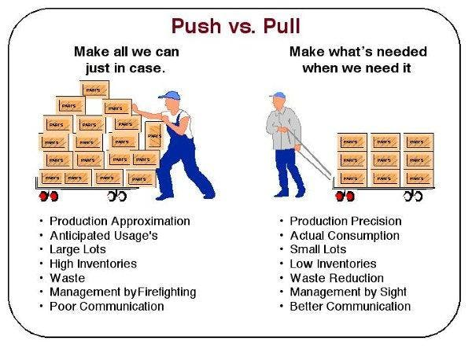
On Demand Manufacturing
AM facilitates on-demand manufacturing or manufacturing on demand
A method of producing goods only when needed and only in the amounts required
A process of manufacturing wherein the goods are manufactured when they are required by the customer and not before-hand as in the case of traditional manufacturing methods.
Closely tied to decentralized manufacturing by producing only those products that are in demand in a specific region or country
More production flexibility and removes the costs that come with housing inventory
Replenishment of spare parts (normally a headache for many firms) would no longer be an issue as AM allows to produce these parts on site when needed.
Shift from “push supply chains” to “pull supply chains”
A push production system is one that has no explicit limit on the amount of work in process (WIP) that can be in the system
A pull production system is one that explicitly limits the amount of work in process that can be in the system
These changes will radically alter supply chains. Because there will be fewer parts, fewer companies will participate in the chain of firms that bring a product to market. Similarly, since production will take place closer to the customer, and will likely be pulled by the customer rather than pushed into the market.
Source: https://www.industryweek.com/cloud-computing/article/22023873/push-vs-pull-manufacturing-is-a-kanban-pull-system-right-for-your-company

Slide 15
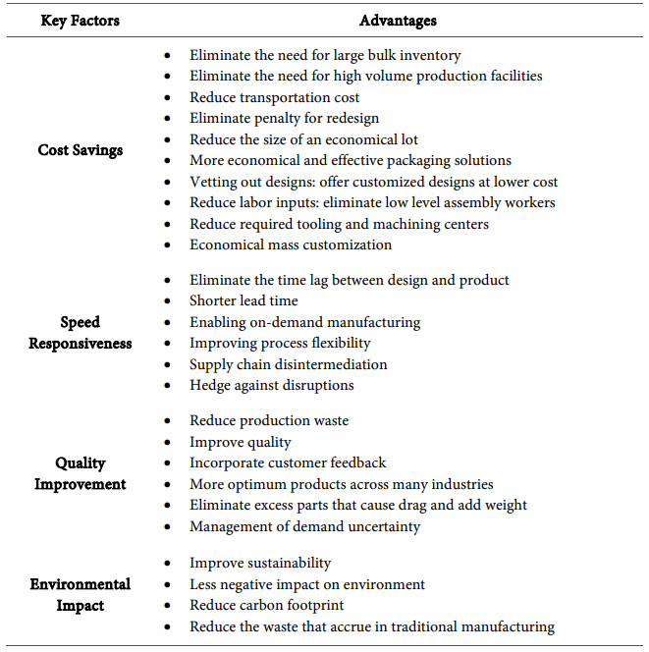
AM and benfits of SC transformation
AM has been pushed beyond the realm of prototyping
As AM becomes more available, it will play a bigger role in future supply chains
The advantage of AM impact on supply chains
Cost savings
Speed responsiveness
Quality improvement
Environmental impact

Slide 16
Thank you for your attention!

