Slide 1
Building logistics competence in the Arctic
Technological Competence Center for Arctic Logistics Operations (ArcLog)
Faculty of Engineering Science and Technology
UiT The Arctic University of Norway
Lodve Langes Gate 2, 8514 Narvik
Norway

Slide 2
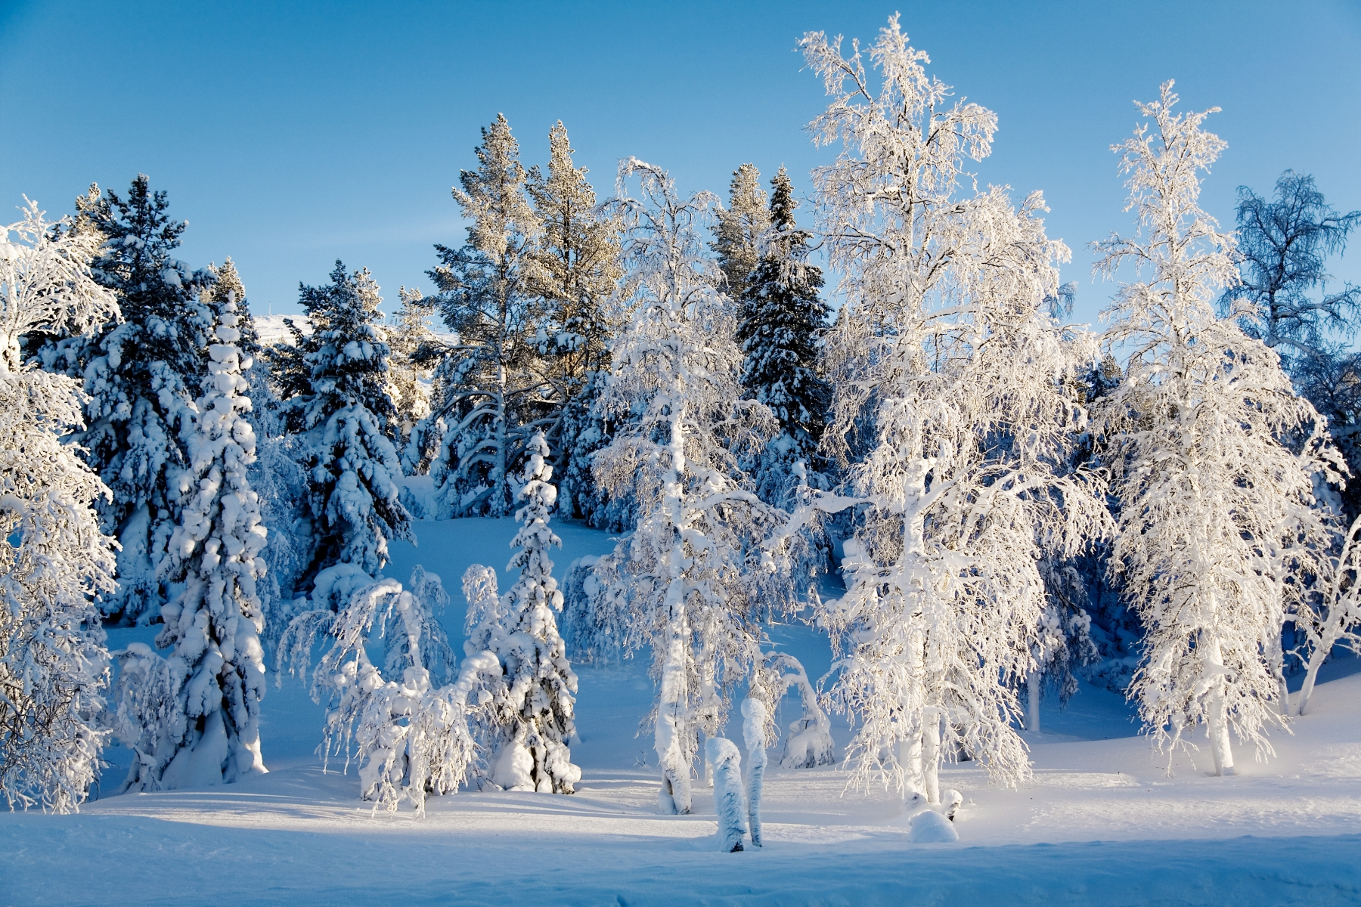
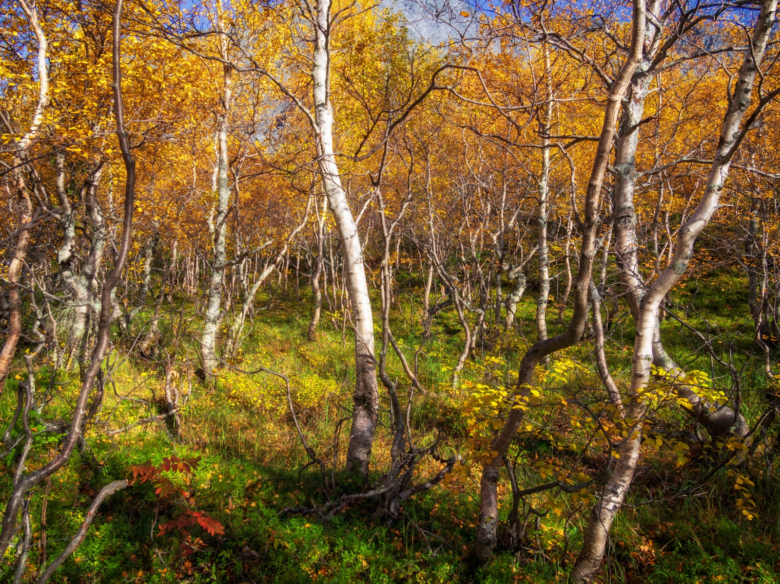
Notes:
The Arctic region is home to 4 million people. With only one in ten thousand of the world's population living in the region, it has
some of the world's largest remaining untapped oil and gas reserves. One third of potential offshore oil and natural gas reserves are in the Arctic. And currently the Arctic produces approx. 10% of the world's oil and 25% natural gas.
2. The Arctic holds also 20% of the Earth's water supply
3. And the annual total fisheries and aquaculture production in the Arctic region in 2016 already reached 17.4 million tonnes and, accounted for 10% of global production. (http://www.fao.org/3/i9540en/i9540en.pdf)
4. The Arctic region is also rich in metal and minerals: gold, diamonds, copper, nickel, iron, zinc, uranium, and other rare earth elements
However, the Arctic faces also challenges due to its sparse population and fragile environmental conditions as well as limited logistics networks.

Slide 3
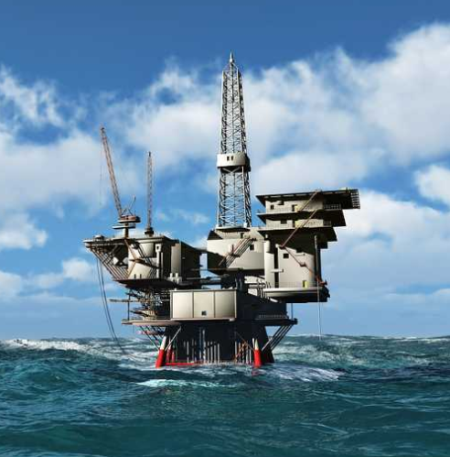
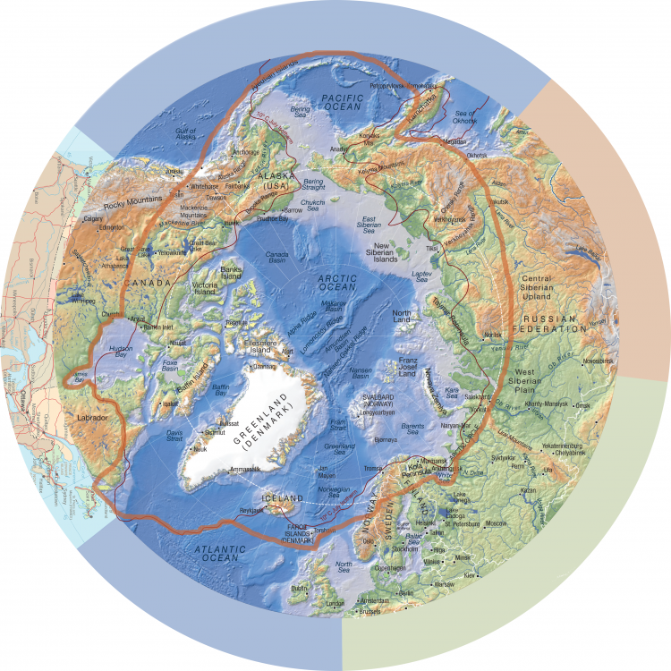
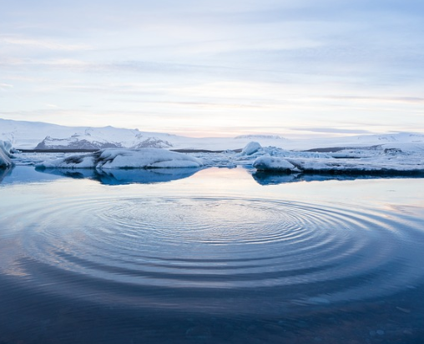
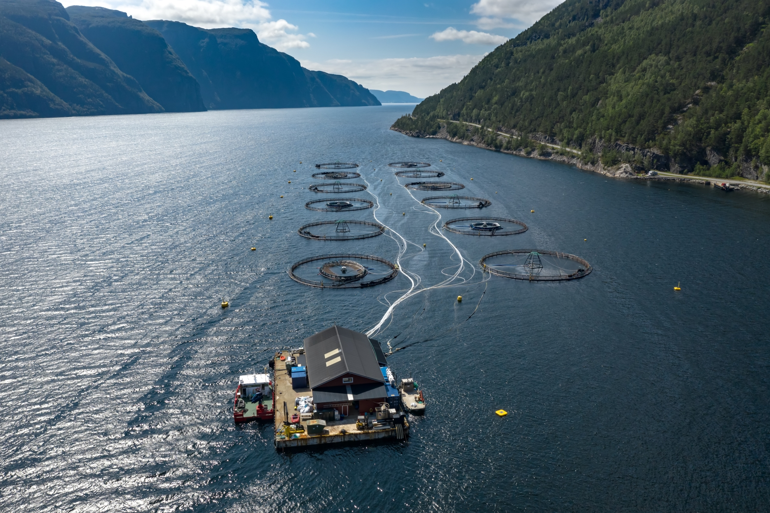
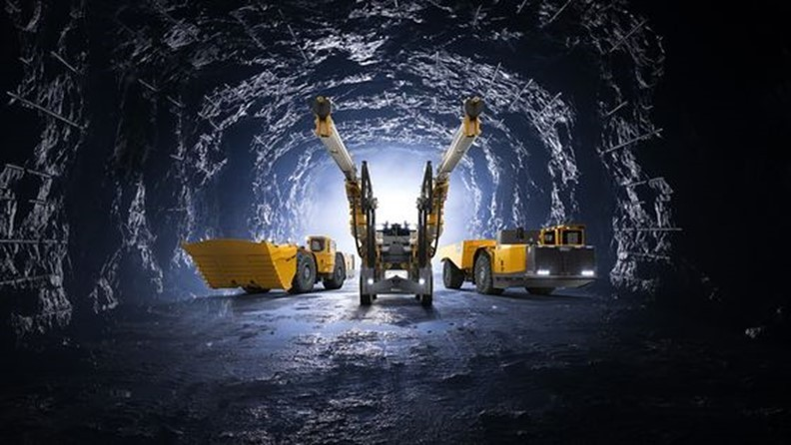
Notes:
I believe no one here doubts the importance of the Arctic:
The Arctic region is home to 4 million people. With only one in ten thousand of the world's population living in the region, it has
some of the world's largest remaining untapped oil and gas reserves. One third of potential offshore oil and natural gas reserves are in the Arctic. And currently the Arctic produces approx. 10% of the world's oil and 25% natural gas.
2. The Arctic holds also 20% of the Earth's water supply
3. And the annual total fisheries and aquaculture production in the Arctic region in 2016 already reached 17.4 million tonnes and, accounted for 10% of global production. (http://www.fao.org/3/i9540en/i9540en.pdf)
4. The Arctic region is also rich in metal and minerals: gold, diamonds, copper, nickel, iron, zinc, uranium, and other rare earth elements
However, the Arctic faces also challenges due to its sparse population and fragile environmental conditions as well as limited logistics networks.

Slide 4
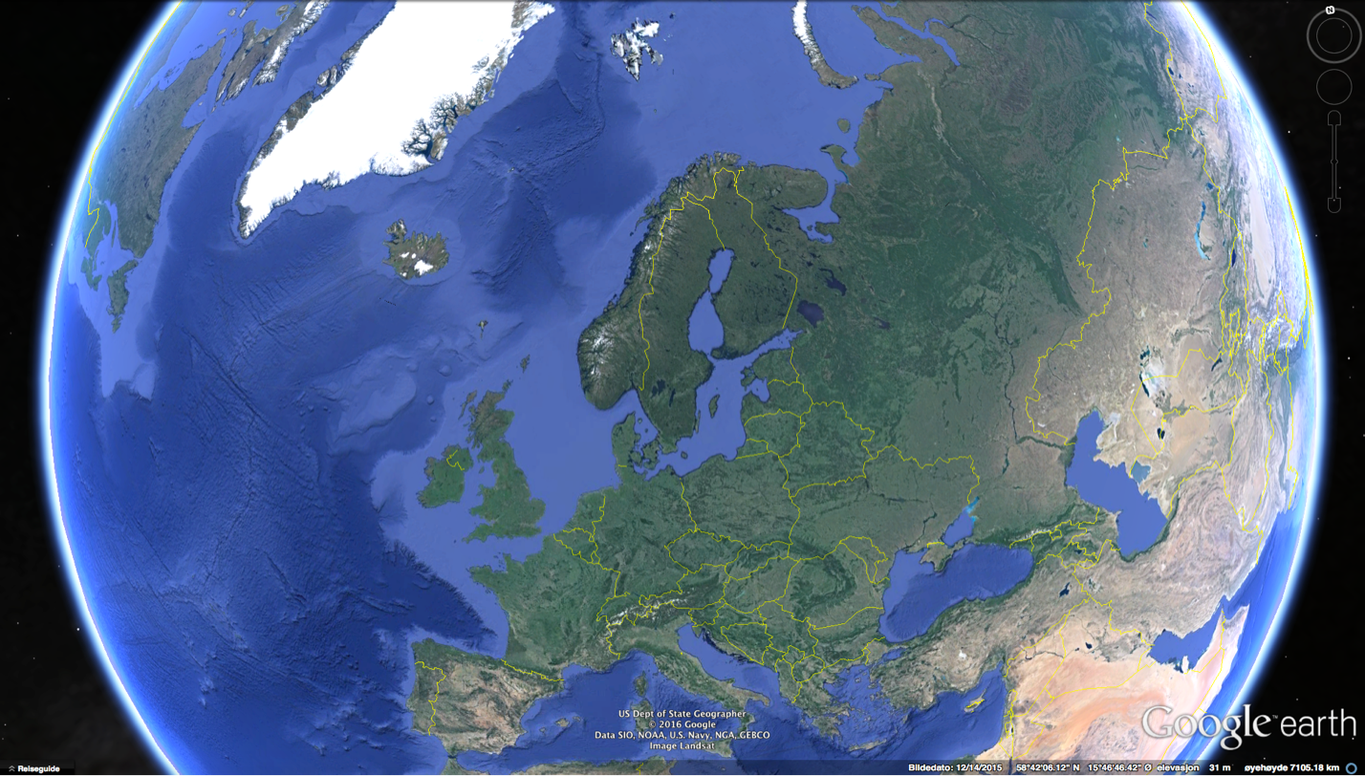
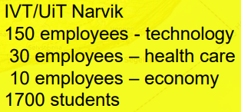
2021:
Employees
3 776
Students
17 982
Budget
458 M USD
PhD candidates
132 (average 110/year)
Longyearbyen
Hammerfest
Kirkenes
Tromsø
Alta
Harstad
Bardufoss
Narvik
Bodø
Mo i Rana
Notes:
The World's Northernmost University
Established in 1968
6 Faculties
6 Campuses
2021 numbers: xx students; xxx employees

Slide 5
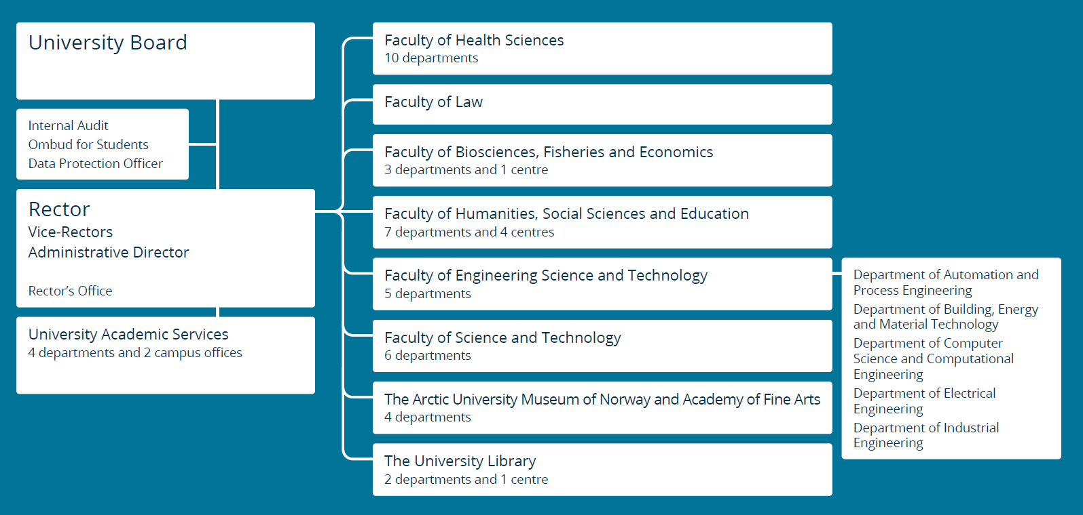
https://vimeo.com/87451334
UiT The Arctic University of Norway
https://vimeo.com/707563184?embedded=true&source=vimeo_logo&owner=92010149

Slide 6
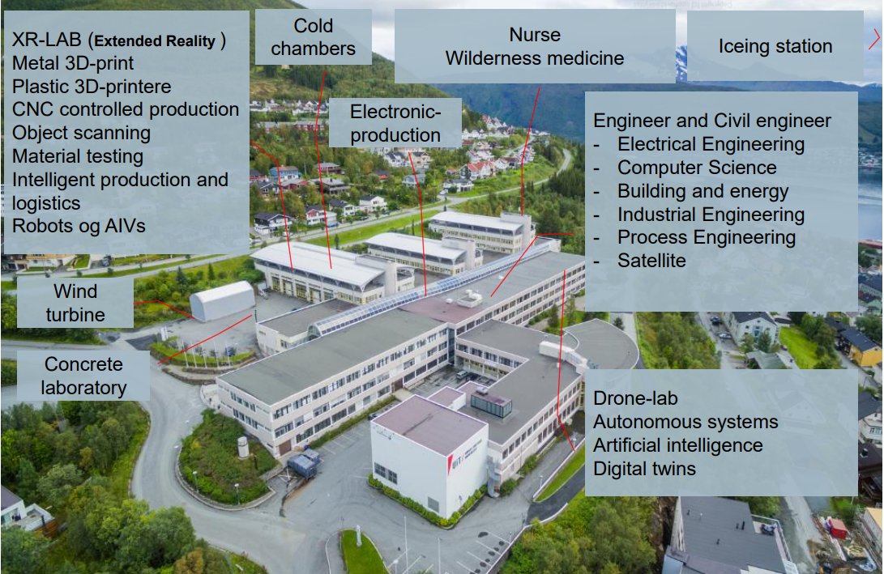
Notes:
Matsuura LUMEX Avanse – 60 hybrid

Slide 7
Our mission
ArcLog
Industries
Private and public organizations
Education
Research
Develop logistics expertise that is particularly relevant to the Arctic
Build logistics capabilities in key industries in the region through long-term collaboration in joint research and education

Slide 8
Aquaculture
Health
Tourism
Manufacturing
Transportation

Slide 9
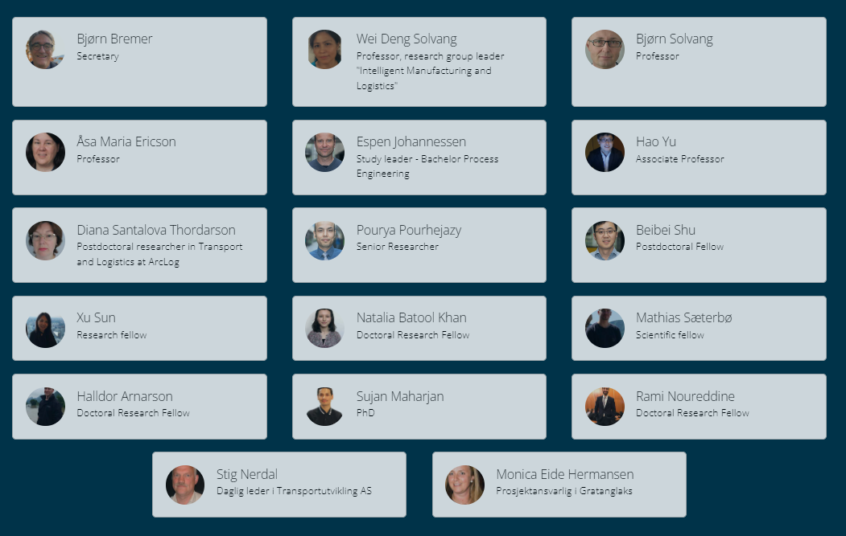
Our team

Slide 10
Some of our current projects
TRINITY
I2P
RoboDemo
GLOW2.0
IDiD – implementation of DED AM in future manufacturing

Slide 11
TRINITY – EU funded

Slide 12
TRINITY – EU funded

Slide 13
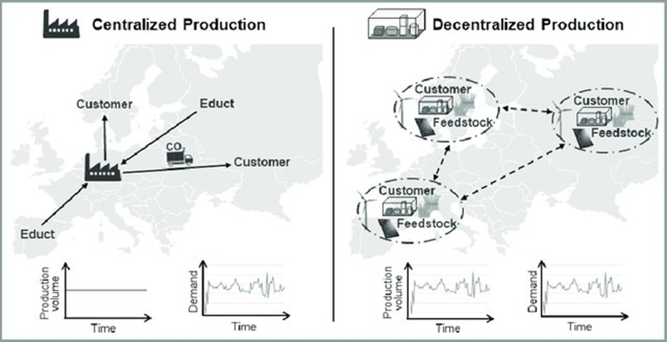
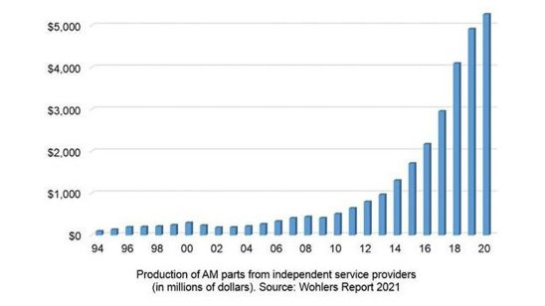
Current PhD project
1. Framing disrupting technologies for sustainable agile manufacturing logistics
Source: Modular Production with Bio-Based Resources in a Decentral Production Network. Marco Finkbeiner

Slide 14
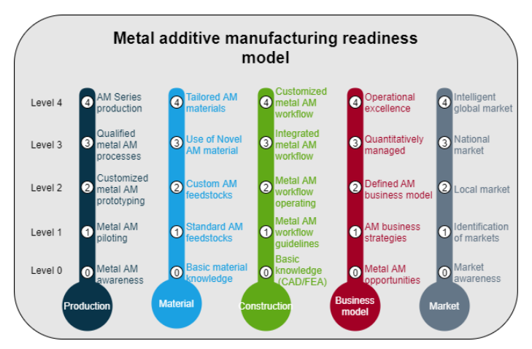
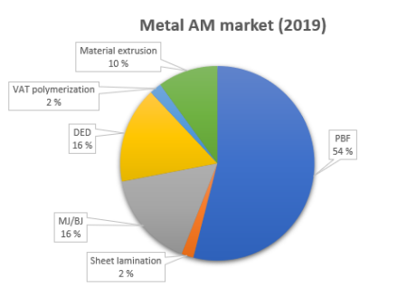
Current PhD project
1. Framing disrupting technologies for sustainable agile manufacturing logistics
Published in GTSD 2022 , Springer
L. Cherdo, “Best metal 3D printers in 2022

Slide 15
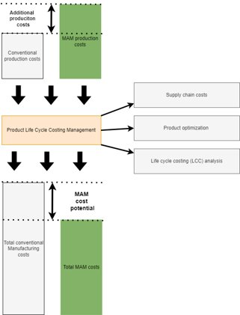
Current PhD project
1. Framing disrupting technologies for sustainable agile manufacturing logistics
- a conceptual cost framework for Metal MEX
Submitted to International Journal of Production Economics

Slide 16
Current PhD project
2. Sustainable Epidemic Logistics Management
Aim
Provide compresensive understanding of epidemic logistics
Provide its clearly state goal
Construct a general operational framework for epidmici logistics management
Approach
Finding gaps on existing epidemic logistics
Review on logistic operation during epidemic
Past epidemic-logistic related responses
Epidemiology and surveillance system
16

Slide 17
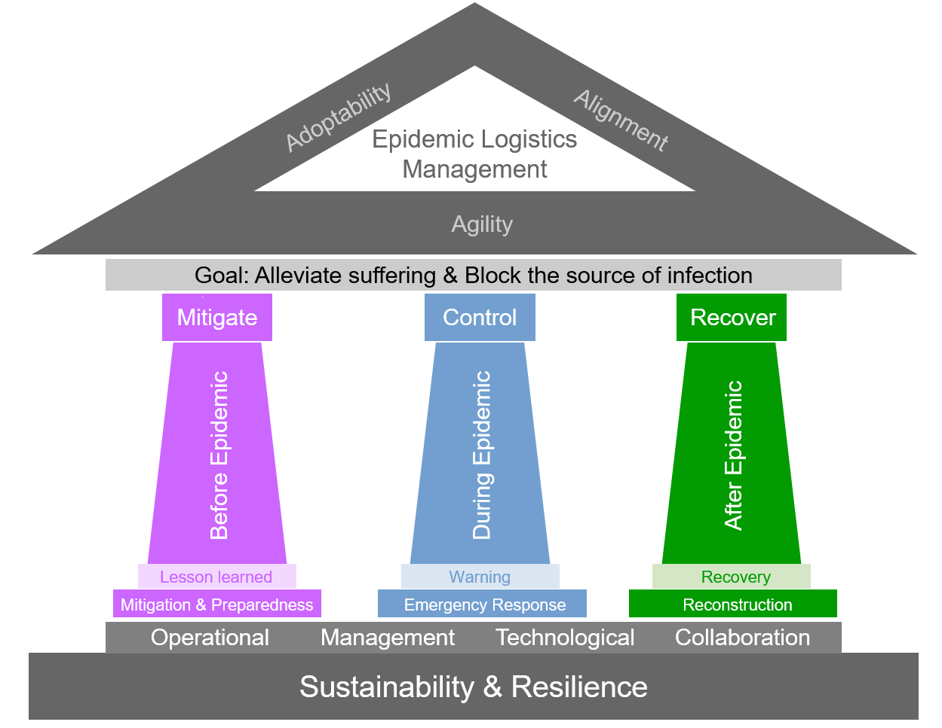
Current PhD project
2. Sustainable Epidemic Logistics Management
Humanitarian Logistics -
“…for the purpose of alleviating the suffering of vulnerable people….” [Thomas and Kopczak, 2007]
Epidemic Logistics
Humanitarian Logistics
Epidemic Logistics -
“…series of coordinated logistics activities aiming at effectively limiting and curbing the spread of a disease….”
Challenges it brings are unique & scalable (if not controlled)
Lacks historical data
Uncertainty and unpredictability
ELM
Prediction
Preventing
Preparing
Detecting
Responding
Controlling
A General Framework for Epidemic Logistics Management (ELM) - Published at IEEE IWAMA 2022
17

Slide 18
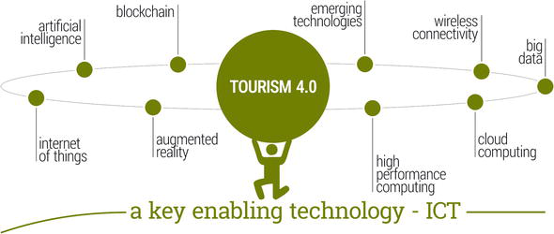
Current PhD project
3. Digitalization for Sustainable Tourism in the Arctic Region
Sustainable tourism management system: is a human-centered system that aims to create personalized traveling experiences by integrating all tourism stakeholders within a collaborative innovation process
Tourism 4.0 enabling technologies. Peceny et. al (2019)
18

Slide 19
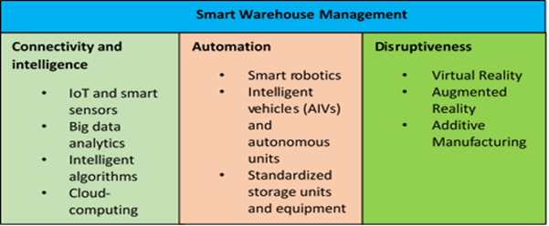
Current PhD project
4. IIoT-based Smart Warehouse Management System
Building up a fully-automated, digitized warehouse management system with high-level of intelligence for 100% traceability of consumables and spare parts at both onshore and offshore warehouses
reducing 50% of current inventory is expected to contribute 50% improvement at the bottom line
19

Slide 20
Current PhD project
5. Self-Configurable Manufacturing system for batch-size-1

Slide 21
Future Cooperation
Joint research projects
Cooperative PhD Education
…

