Slide 1




UNIVERSITY OF ŽILINA
FACULTY OF MECHANICAL ENGINEERING
EDUCATION, RESEARCH & DEVELOPMENT ACTIVITIES
29.11.2022
Notes:
Your Magnificence, Your Excellence,
Dear members of Arctic University of Norway, Secondary school of Dubnica nad Váhom, Dear Ladies and Gentlemen,
I’m Michal Šajgalík and I’m vice-dean for cooperation with industry at Faculty of Mechanical Engineering at University of Zilina.
Now I would like to say some information about applicant organisation, about Faculty of Mechanical Engineering at University of Žilina.

Slide 2
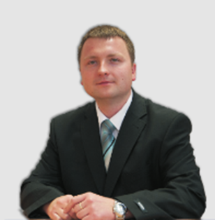
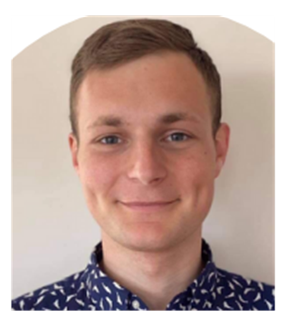
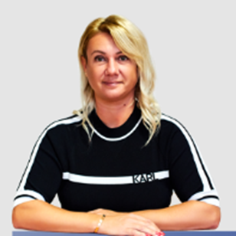
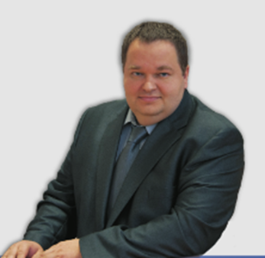
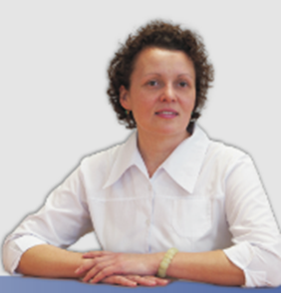
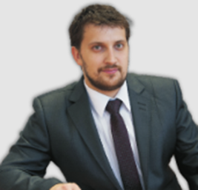
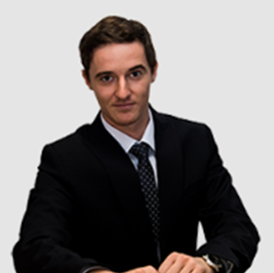
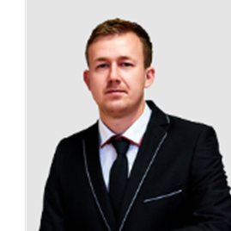
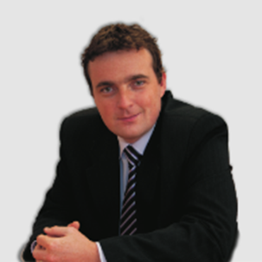
University of Žilina – applicant (team)
Mário Drbúl
Main project coordinator
Vladimír Bechný
Project coordinator
UNIZA PR manager
Miriam Tatranská
Finance Manager
Andrej Czán
Professional
Tatiana Czánová
Professional
Jozef Holubják
Professional
Richard Joch
Professional
Miroslav Cedzo
Professional
Michal Šajgalík
Professional
Notes:
Firstly, I would like to introduce team of applicant organisation which include management team and team of professionals:

Slide 3

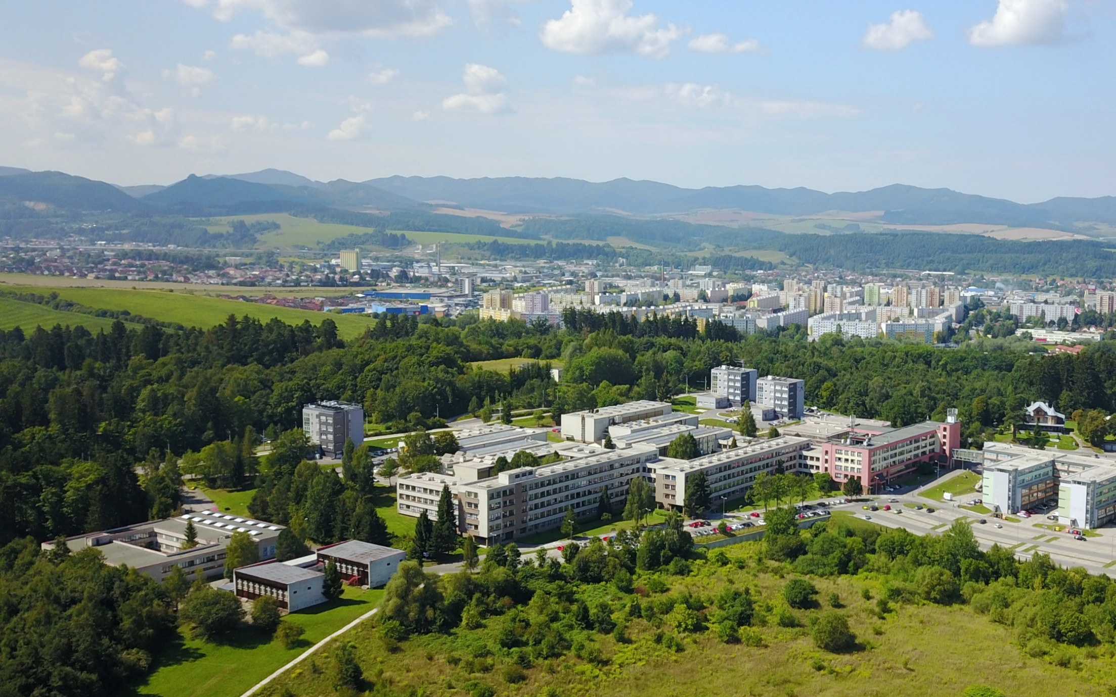
University Campus
Notes:
Now, I would like to tell You about University of Žilina, especially Faculty of Mechanical Engineering.
Žilina and the University of Žilina are located in the northwest of Slovakia near the borders with Poland and the Czech Republic. The university campus is situated in the outskirts of the city, in direct contact with nature. The campus includes the individual faculties of the university, lecture halls, laboratories, but also provides space for students to relax.

Slide 4
University of Žilina (UNIZA): faculties
Faculty of Operation and Economics of Transport and Communications
Faculty of Operation and Economics of Transport and Communications
počiatky a história na UNIZA;
aditívne technológie pre protyping;
aplikácie:
  analýza mechanických vlastností;
  analýza metrologických vlastností;
Faculty of Mechanical Engineering
Faculty of Electrical Engineering and Information Technology
Faculty of Electrical Engineering and Information Technology
Faculty of Civil Engineering
Faculty of Civil Engineering
Faculty of Security Engineering
Faculty of Security Engineering
Faculty of Management Science and Informatics
Faculty of Management Science and Informatics
Faculty of Humanities
Faculty of Humanities
Notes:
Technologies of additive manufacturing undoubtedly find their place in every area of our life. Similarly, there is no faculty at University of Zilina, where you would not find their use to a lesser or greater extent.
The Faculty of Engineering is one of the seven faculties of the University of Zilina, and as its name suggests, its educational and research activities are related to mechanical engineering and other related areas of industry, such as aerospace, automotive, transport, bearing and also medical industry. It is also founding and one of oldest faculties of the University.

Slide 5
History
1953 – establishment of a detached workplace of the Technical University Prague (CVUT Praha) as Transport College (Faculty of Mechanical and Electrical Engineering);
1959 – Transport College was renamed to University of Transport
1992 – separate faculties: Faculty of Mechanical Engineering and Faculty of Electrical Engineering;
1996 – University of Transport and Communications was transformed to University of Žilina
1500 – full-time students actually (Faculty of Mechanical Engineering)
Notes:
Educational and research activities follow the beginnings of UNIZA, when in 1953 the detached workplace of CTU Prague was separated and the Transport College was established. In the current academic year, we are commemorating the 70th anniversary.
Over the years, there have been several changes in either the name or the structural nature. The university as we know it today has been writing its history since 1996.
Around 1,500 full-time students are currently studying at the Faculty of Mechanical engineering.

Slide 6
UNIZA: Faculty of Mechanical Engineering
Dpt. of Machining and Production Technologies
Dpt. of Technological Engineering
počiatky a história na UNIZA;
aditívne technológie pre protyping;
aplikácie:
  analýza mechanických vlastností;
  analýza metrologických vlastností;
Dpt. of Design and Mechanical Elements
Dpt. of Material Engineering
Dpt. of Automation and Production Systems
Dpt. of Industrial Engineering
Dpt. of Transport and Handling Systems
Dpt. of Power Engineering
Dpt. of Applied Mechanics
Dpt. of Applied Mathematics
Notes:
There are 10 departments within the faculty, the individual focuses of which are contained in their names.
Through the departments, we cover educational and research activities from computations, design and construction to production. From the microstructure of materials to complex constructions. From manual and conventional technologies to the application of artificial intelligence or image recognition. From traditional approaches to industry to new trends following the framework and requirements of Industry 4.0.

Slide 7
Education activities
1
Bachelor Study (3 years)
2
Master Study (2 years)
3
Doctoral Study (3 years)
5 programmes
7 programmes
7 programmes
Notes:
The Slovak higher education system consists of three levels. We provide education in all three levels of higher education.

Slide 8
Education activities
Bachelor study:
  energy and environmental technology
  industrial engineering
  computer engineering and simulations
  engineering technologies
  vehicles and engines
Notes:
According to focus of individual departments, our faculty provides following programmes in bachelor study.

Slide 9
Education activities
Master study:
  automated production systems
  industrial engineering
  engineering technologies
  vehicles and engines
  technical materials
  computer modeling and simulations in engineering
  environmental technology
Notes:
According to focus of individual departments, our faculty provides following programmes in master study.
It can be seen, that the individual programmes are more detail focused on various issues of mechanical engineering.

Slide 10
Education activities
Doctoral study:
  automated production systems
  industrial engineering
  engineering technologies
  technical materials
  machine parts and mechanisms
  energy machines and devices
  rolling stock
Notes:
Doctoral studies, in terms of focus, are a continuation of engineering studies. Students develop their engineering skills and they are focusing more on research and academic activities.

Slide 11
Ranking the University and Faculty
According the ARRA (2012 - 2015):
University of Žilina obtained the 3rd place in the framework of Technical universities in Slovakia
Faculty of Mechanical Engineering obtained the 1st place in the framework of technical slovak faculties (from 2010 to 2015)
TOP 3 of Slovak universities according QS World University Rankings 2022
ARRA is Academic Ranking and Rating Agency and it is an independent Slovak civil association
Notes:
Based on educational and research activities, the University of Žilina and the Faculty of Mechanical Engineering are regularly ranked among the best in Slovakia, according to both national and international independent evaluations.

Slide 12

The most important industry references....
Schaeffler Kysuce, spol. s r.o. – Kysucké Nové Mesto, SK + Germany
Volkswagen Martin, Slovakia + Germany
KIA motors Slovakia
SAS FLERTEX Matériaux de friction, France
Triple D Bending, Canada
Beijing Puran Railway Braking Technology, China
BONATRANS GROUP a.s., Czech republic
ELMAX ŽILINA, a.s. – Žilina, SK
MEDEKO CAST, s.r.o. – Považská Bystrica, SK
SaarGummi Slovakia, s.r.o. - Dolné Vestenice, SK
Železničná spoločnosť Slovensko – Bratislava, SK
TSU Piešťany, š.p. – Piešťany, SK
LADAN, s.r.o. - Horná Štubňa, SK
Notes:
In addition to its own research and educational activities, the Faculty also offers its capacities to industry partners. I can say that we have developed cooperation with important Slovak companies, Slovak branches of foreign companies, but also directly with foreign companies.

Slide 13
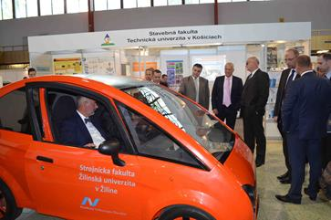
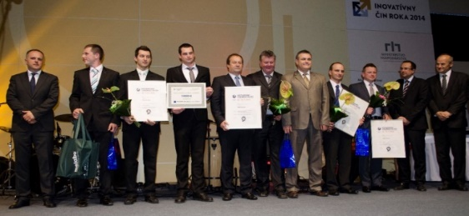
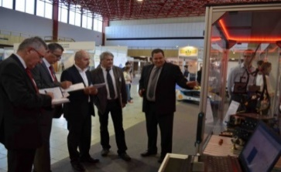
Awards
International Engineering Fair
Nitra, Slovakia
2014 Mechanical product of the year – prototype of city e- mobile car „EDISON“
Acknowledgement of fair EMA – Inteligent system for non-destructive technology for valuation of functional product properties „X-ray difraktometry“
2015 Acknowledgement of fair EMA – Automated measurement system for fuel dispensing pump
2016 Honourable mention - Linear tribometer
2017 Award of fair – RAILBCOT – Testing of brake components for track car
Notes:
Based on the above-mentioned activities, the university won several awards at the international engineering fair in Nitra, whether in the field of automotive, metrology, tribometry, etc.

Slide 14
Focus
Principal direction of the Faculty in R&D
1. Intelligent production systems, digital engineering
based on Industry 4.0
2. Advanced materials and technologies
3. Green energy for transport and alternative energy
sources
Notes:
The educational and research activities of the faculty are concentrated in three basic pillars, respecting the current trends

Slide 15
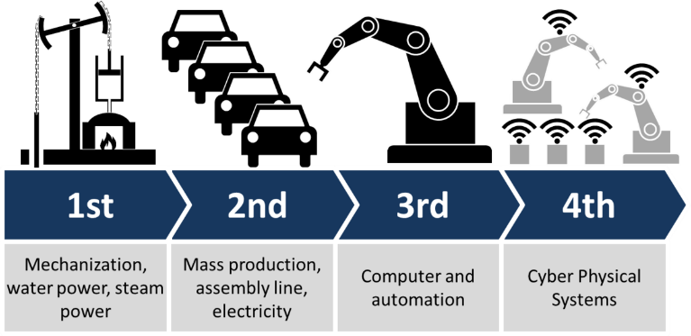
Research and Development activities
Intelligent production systems, digital engineering based on Industry 4.0
Intelligent manufacturing systems
Digital engineering
Digital and industrial engineering
Smart automation
Robotics
Simulation and modelling of processes and systems
Artificial intelligence in production systems
Analytical data processing – Production intelligence methods
Additive manufacturing

Slide 16
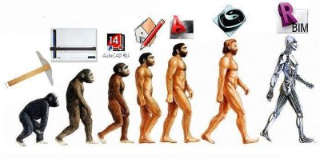
Research and Development activities
Advanced materials and technologies
X-ray non-destructive diagnostics of material properties
Structural analysis of materials
Lifetime prediction of thermally loaded parts
Fatigue resistance of materials study
Research of rheological properties of polymers
Determination of fracture mechanism
High speed machining
Hard machining
Dry machining
Materials for automotive

Slide 17


Research and Development activities
Green energy for transport and alternative energy sources
Testing materials for green operations
Green transport means
E-mobility
Thermal treatment of biomass
Solar and biomass energy
Geothermal energy technology
Notes:
Spomenúť brzdný stav, EDISON automobil, ...

Slide 18
Additive manufacturing at Faculty
Rapid prototyping, Reverse engineering
  Dpt. of Design and Mechanical Elements:
  Medvecký, Hrčeková, Hrček, Madaj, Kohár,...;
Materials research
  Dpt. of Material Engineering:
  Konečná, cooperation with University of Parma (ITA)
Mechanical properties
  Dpt. of Applied Mechanics:
  Sága, Vaško, Handrík, Majko
Applications for industry
  Dpt. of Machining and Production Technologies:
  Czán, Šajgalík, Joch,...;
Notes:
Technologies of additive manufacturing undoubtedly find their place in every area of our life. Similarly, there is no faculty at University of Zilina, where you would not find their use to a lesser or greater extent.
However, I dare to say that the widest coverage both in the field of education and research is realized precisely at the Faculty of Mechanical Engineering.
One of the first to start dealing with additive technologies at the faculty, there were our colleagues from Dpt. of Design and Mechanical Elements.
Among other departments, the international cooperation with the University of Parma certainly deserves mention. Own research, whether in the field of mechanical properties of materials for additives or direct application for industry, is carried out in the departments.
Computational and practical applications are solved at Dpt. applied Mechanics and Dpt. Machining and Production Technologies.

Slide 19
Additive manufacturing
selected technologies of research focus:
  SLA/DLP – stereolitography;
  SLM – selective laser sintering;
  FFD/FDM – fused filament deposition / fused deposition modeling;
  CFC – continuous fibre composite
  BJ – binder jetting;
  MJF – multi jet fusion;
Notes:
The main focus is on the following technologies (continuous fiber, powder/sintering)
but we do not avoid new challenges.

Slide 20
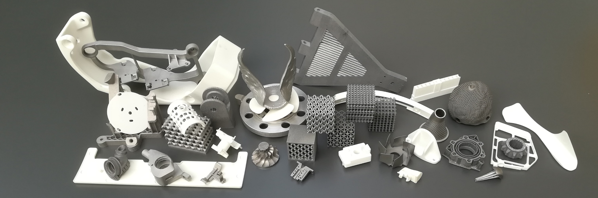
Additive manufacturing
Dpt. of Design and Mechanical Elements:
  rapidprototyping:
  rapid production of models, samples and prototypes in cooperation with industry;
  direct casting:
  molds and cores production based on CAD data
Dpt. archive
Notes:
As I already mentioned, Dpt. Of Design and Mechanical Elements mainly focuses on the use of RP and RI for industry and also the use of CAD data in this area.
Their primary goal is not only to create models, but mainly to increase their quality and accuracy.

Slide 21
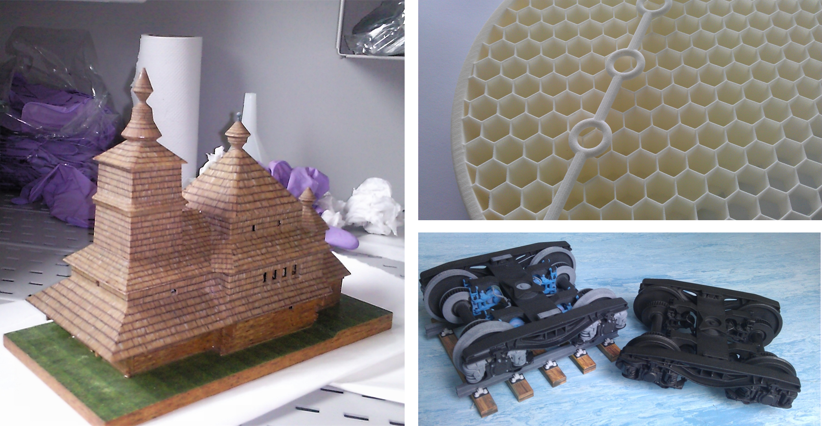
Additive manufacturing
Katedra konštruovania a častí strojov:
  rapidprototyping:
  rýchla výroba modelov, vzoriek a prototypov v rámci spolupráce s praxou
  direct casting:
  výroba foriem a jadier na báze CAD dát
Dpt. archive
Notes:
On these slides, we can see some examples of models and components for tourism, research popularisation and industry.

Slide 22
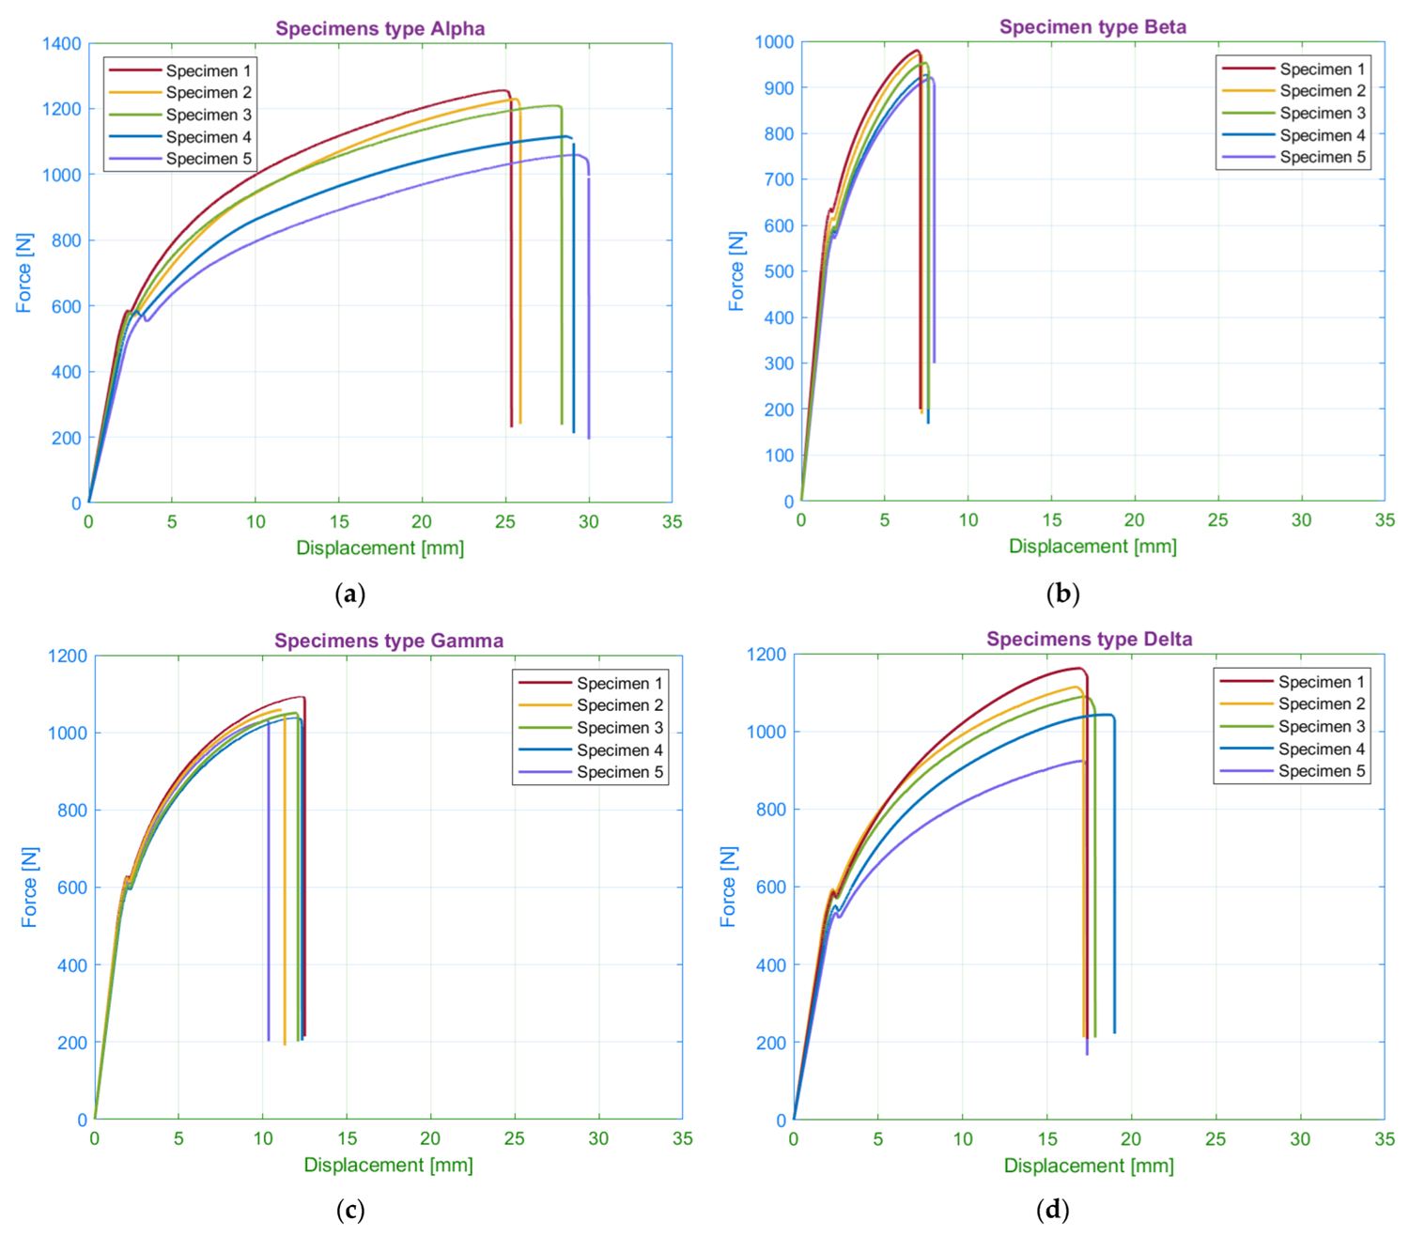
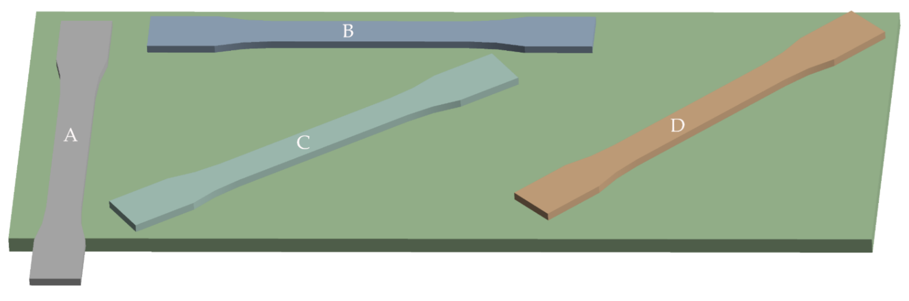
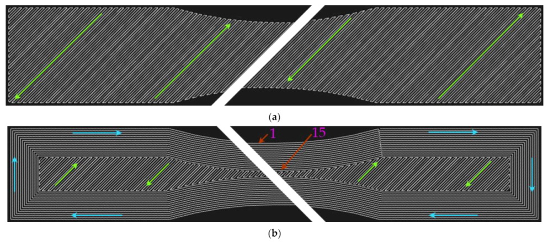
Additive manufacturing
Dpt. of Applied Mechanics
  mechanical analyses:
Majko J, Vaško M, Handrik M, Sága M. https://doi.org/10.3390/ma15124224
Notes:
For several years, the department of Applied Mechanics has been carrying out research in the field of CFM, where they focus on the orientation of fibers in the internal structure of components and their influence on mechanical properties. Several experimental and simulation activities were carried out in this area, which also resulted in publications in renowned scientific journals indexed in CCC.

Slide 23
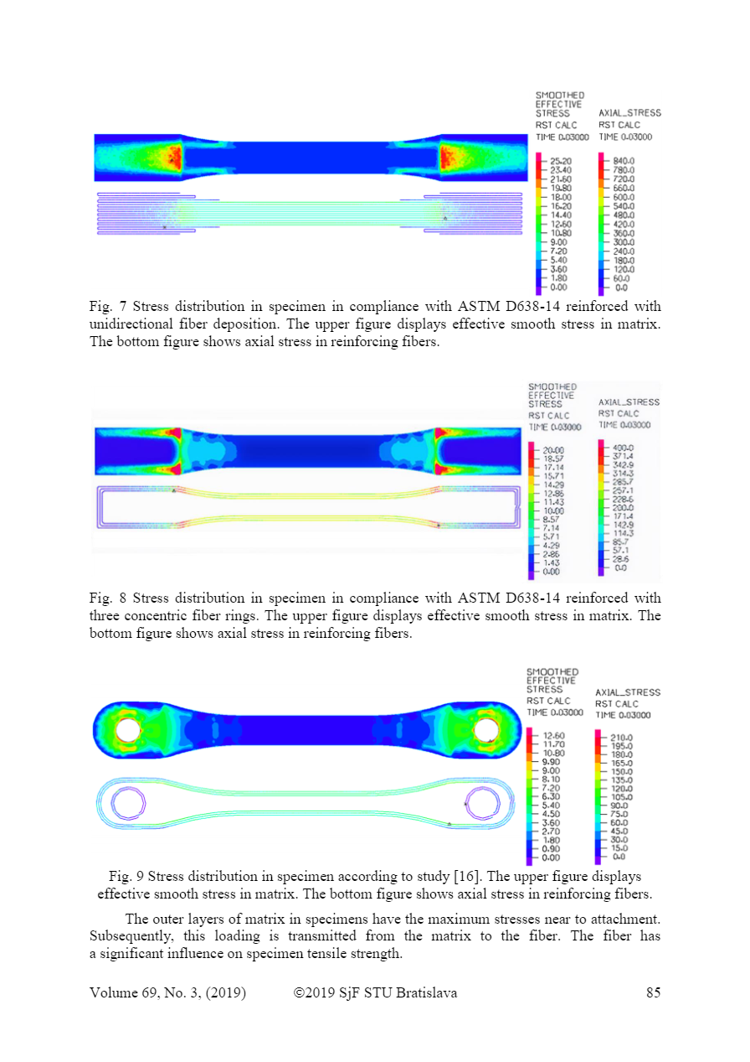
Additive manufacturing
Dpt. of Applied Mechanics
  mechanical analyses:
Handrik M.,Vaško M.,Majko J.,Sága M. and Dorčiak F. https://doi.org/10.2478/scjme-2019-0030
Notes:
For several years, the department of Applied Mechanics has been carrying out research in the field of CFM, where they focus on the orientation of fibers in the internal structure of components and their influence on mechanical properties. Several experimental and simulation activities were carried out in this area, which also resulted in publications in renowned scientific journals indexed in CCC.
Also based on these research activities, there was subsequently applied research carried out for the use of composite materials and components created from these materials by additive technologies at Dpt. Machining and Production Technologies.

Slide 24
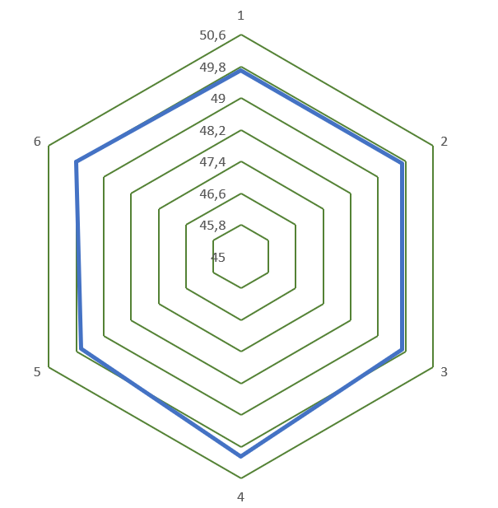
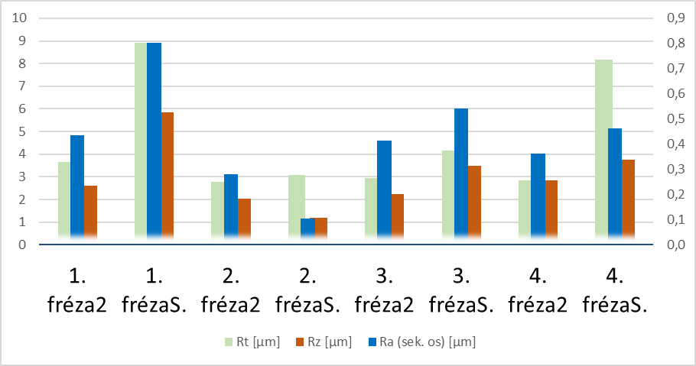
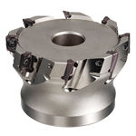
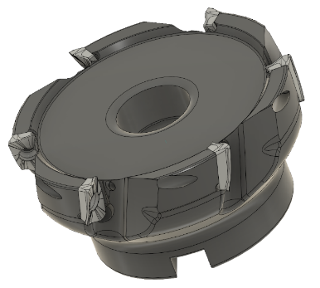
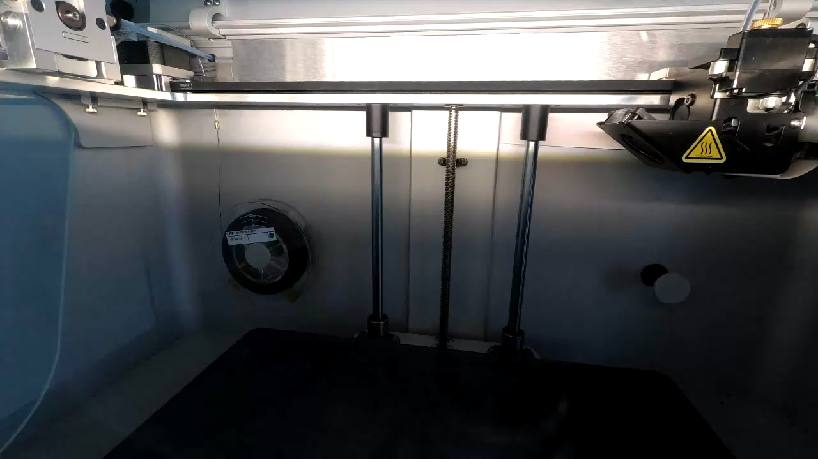
Additive manufacturing
Dpt. of Machining and Production Technologies
milling cutter
(holder)
Dpt. archive
Notes:
First, let me introduce the analysis of the replacement metal tool holder for the milling cutter. In the lower right corner, you can see a time-lapse video of the production process. The main importance lies in the lightening of the tool, which can result in a reduction of vibrations and the use of the tool even for higher speeds. A composite material of nylon and carbon elements with additional carbon fiber reinforcement was chosen as the material. As can be seen in the upper right corner, comparable and in some cases better machined surfaces were achieved than with a conventional milling cutter. At the same time, however, it is necessary to point out that the given material has its reserves, especially in the area of higher temperatures.

Slide 25
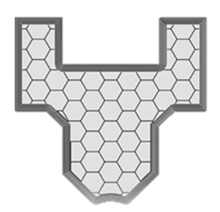
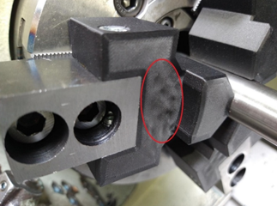
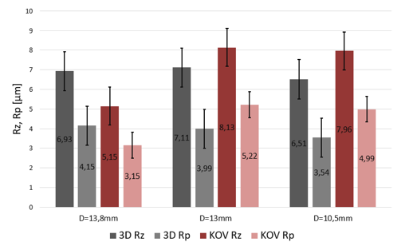
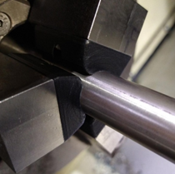
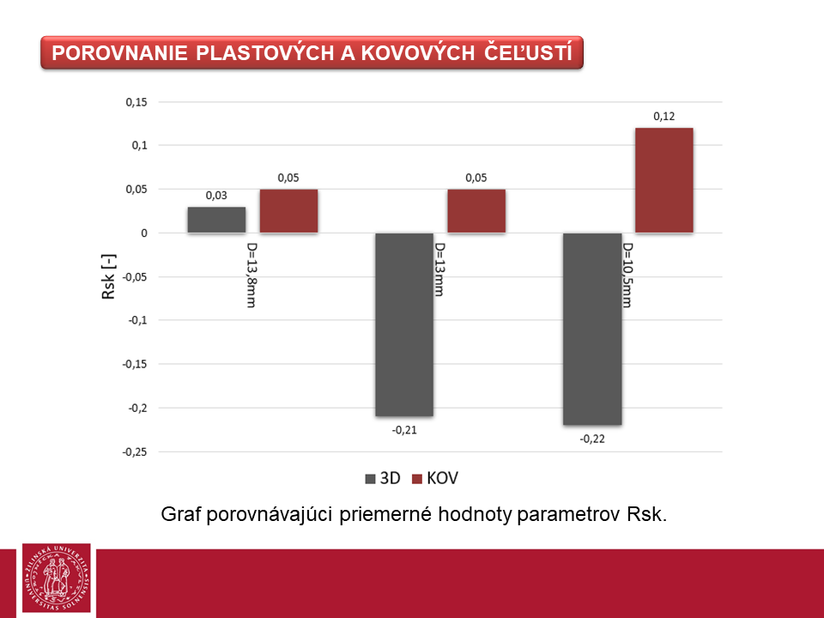
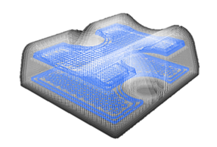
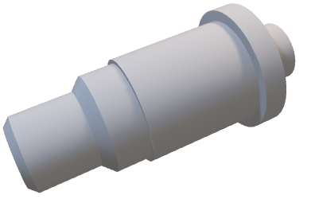
Additive manufacturing
Dpt. of Machining and Production Technologies
  clamping (CFC – supporting carbon fibre):
Dpt. archive
Notes:
Other research addressed the replacement of metal jaws, mainly looking at the elimination of imprints on the machined surface and analyzing the vibrations and the machined surface during such clamping.
In this case, the basic material was again a composite of nylon and carbon elements, while carbon, glass and Kevlar were used as reinforcing fibers.

Slide 26
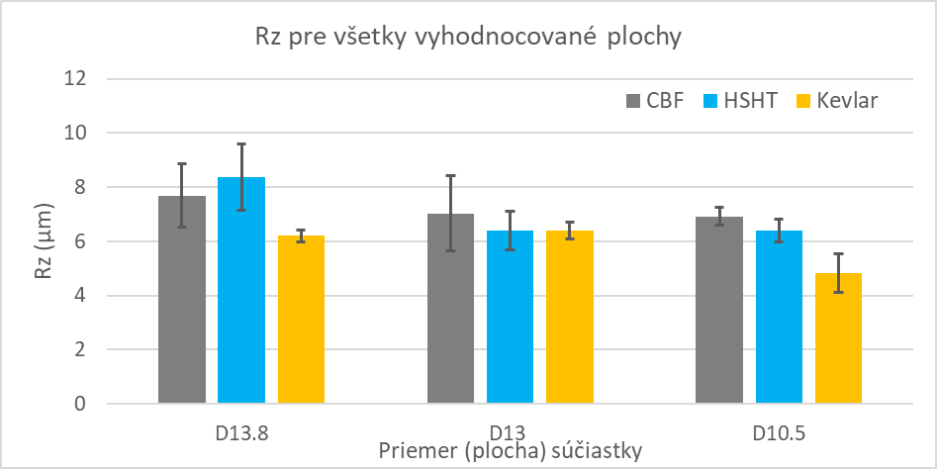
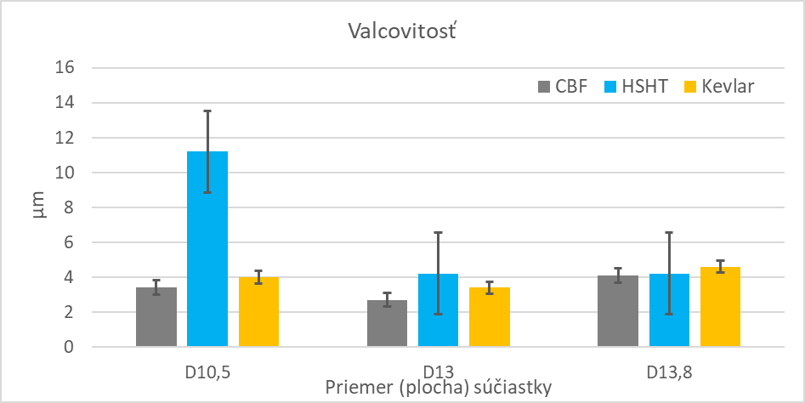
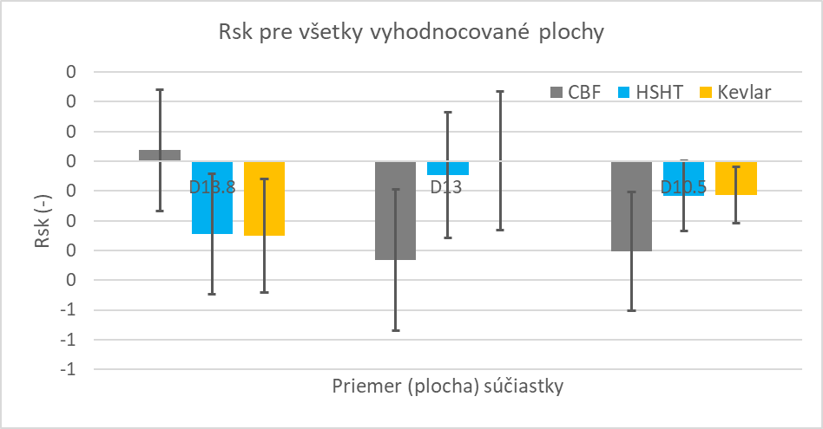
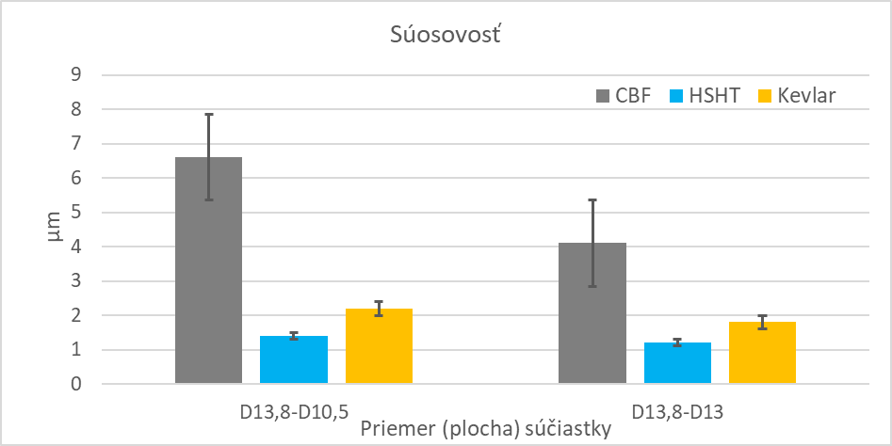
Additive manufacturing
Dpt. of Machining and Production Technologies
  clamping (CFC – supporting continuous fibres):
Notes:
There were analyzed parameters such as surface roughness and geometric deviations and geometric tolerances.
The results after the analysis of the machined samples show that the jaws of the chuck better surround the workpiece, which reduces vibrations and has a positive effect on the quality of the machined surface.

Slide 27
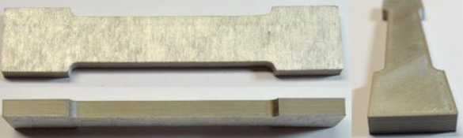
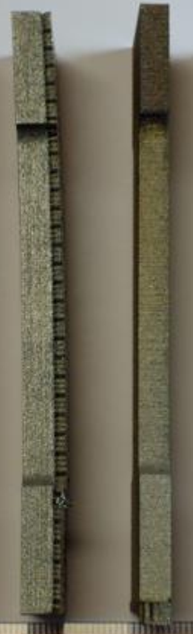
Additive manufacturing
Dpt. of Machining and Production Technologies
  ADAM (cooperation with universities from Czechia):
Dpt. archive
Notes:
(accuracy up to 0,15mm)
In cooperation with the Czech universities from Prague and Ostrava, research was also carried out on ADAM additive technology. This technology is based on the deposition of a fiber formed by a binder and elementary metal particles. After the fibers have been applied, the part is further sintered, which melts the binder and creates the finished part. This deposition and processing of the material results in a reduction of porosity compared to the classical sintering method.
On this slide we can see difference between ADAM technology and SLM. When we use ADAM technology, there are no supports needed.

Slide 28
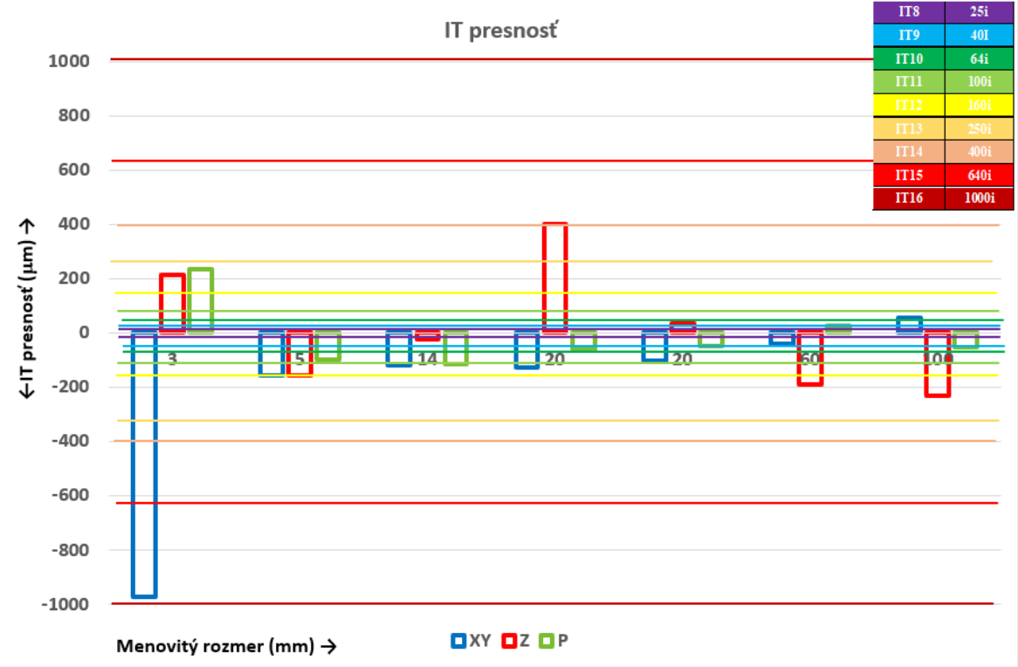
Additive manufacturing
Katedra obrábania a výrobnej techniky
  ADAM (spolupráca s CZ univerzitami):
Dpt. archive
Notes:
And it is not only one advantage. The samples we could see on previous slide were produced in several dimensions and orientations and subsequently analyzed for achievable accuracy.
As we can see on this figure, ADAM technology allow to achieve accuracy at the IT 8 level.

Slide 29
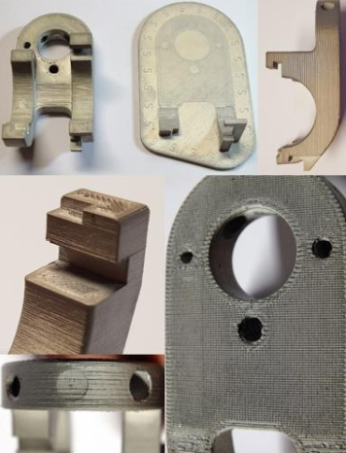
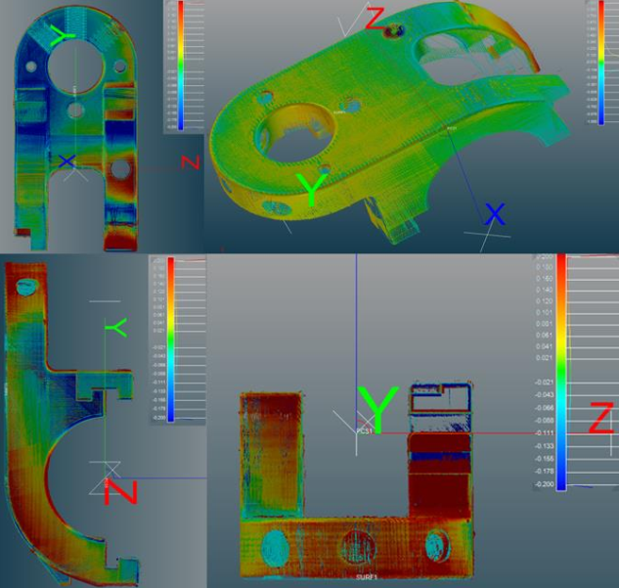
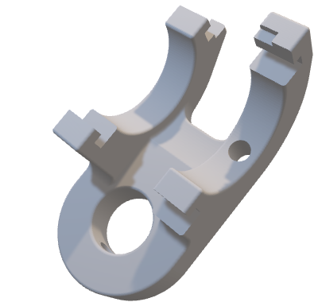
Additive manufacturing
Dpt. of Machining and Production Technologies
  ADAM (cooperation with
  universities from Czechia):
Dpt. archive
Notes:
For industrial use, ADAM technology was deployed as a replacement for conventional technologies in the production of a special holder for a single-purpose machine for the production of bearings. The detected deviations on this part did not exceed 0.15 mm.
And that’s all in the nutshell.

Slide 30

Thank you for your attention
doc. Ing. Michal Šajgalík, PhD.
Notes:
Thank you for your attention and I firmly believe that this project starts a close cooperation between the involved institutions.

