Slide 1


Development of modern egineering educational program in the field of green intelligent manufacturing
BIN SGS02: Call for Proposals for Institutional cooperation between
Higher education institutions, Upper-secondary schools and private sector

Slide 2

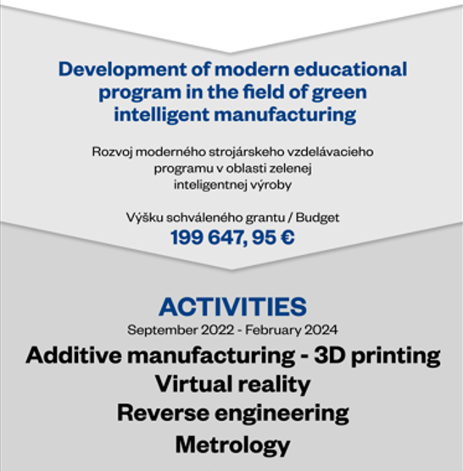

Working together for a green, competitive and inclusive Europe
2

Slide 3
Project goals
Project partnership
New ideas in education and research in the fields (lectures, workshops, cooperation
with industry)
Applicant
University of Žilina
Donor Project Partner
UiT Narvik
Project Partner 2
SPŠ Dubnica nad Váhom
Additive Manufacturing
Metrology
Virtual reality
Reverse Engineering

Slide 4
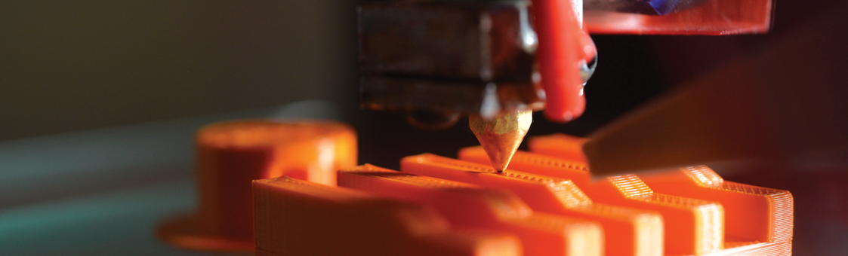
Main project goal
Cooperation within the project will strengthen the basic and complementary competencies of the partners in the field of additive production technology and increase their expertise in the field of modern teaching and pedagogical approaches (flexible education, combined courses, virtual and real mobility).

Slide 5
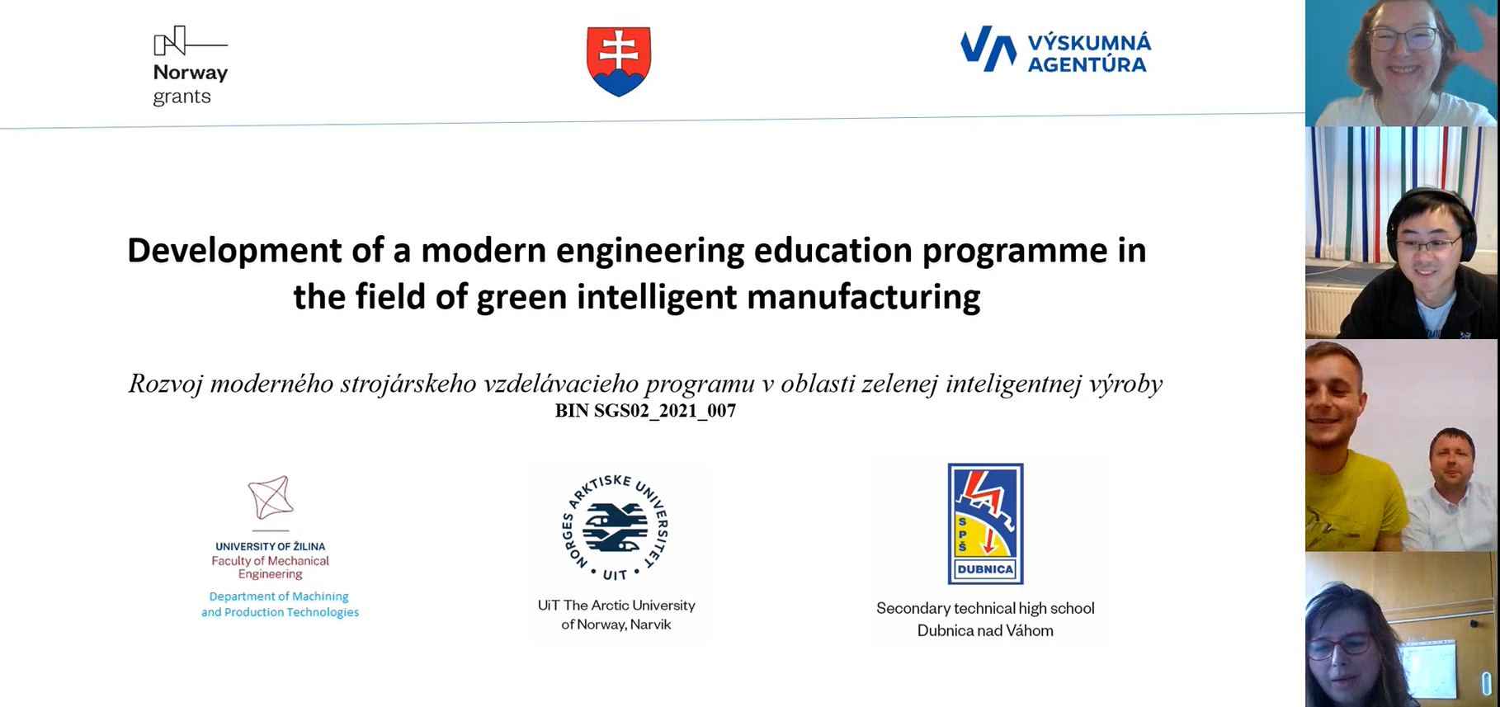
Activities
Project management
Preparation project meeting with all project participants

Slide 6

Activities
Introductory opening Conference (November 2022)
Project presentation and its goals
Your picture will be here ☺

Slide 7

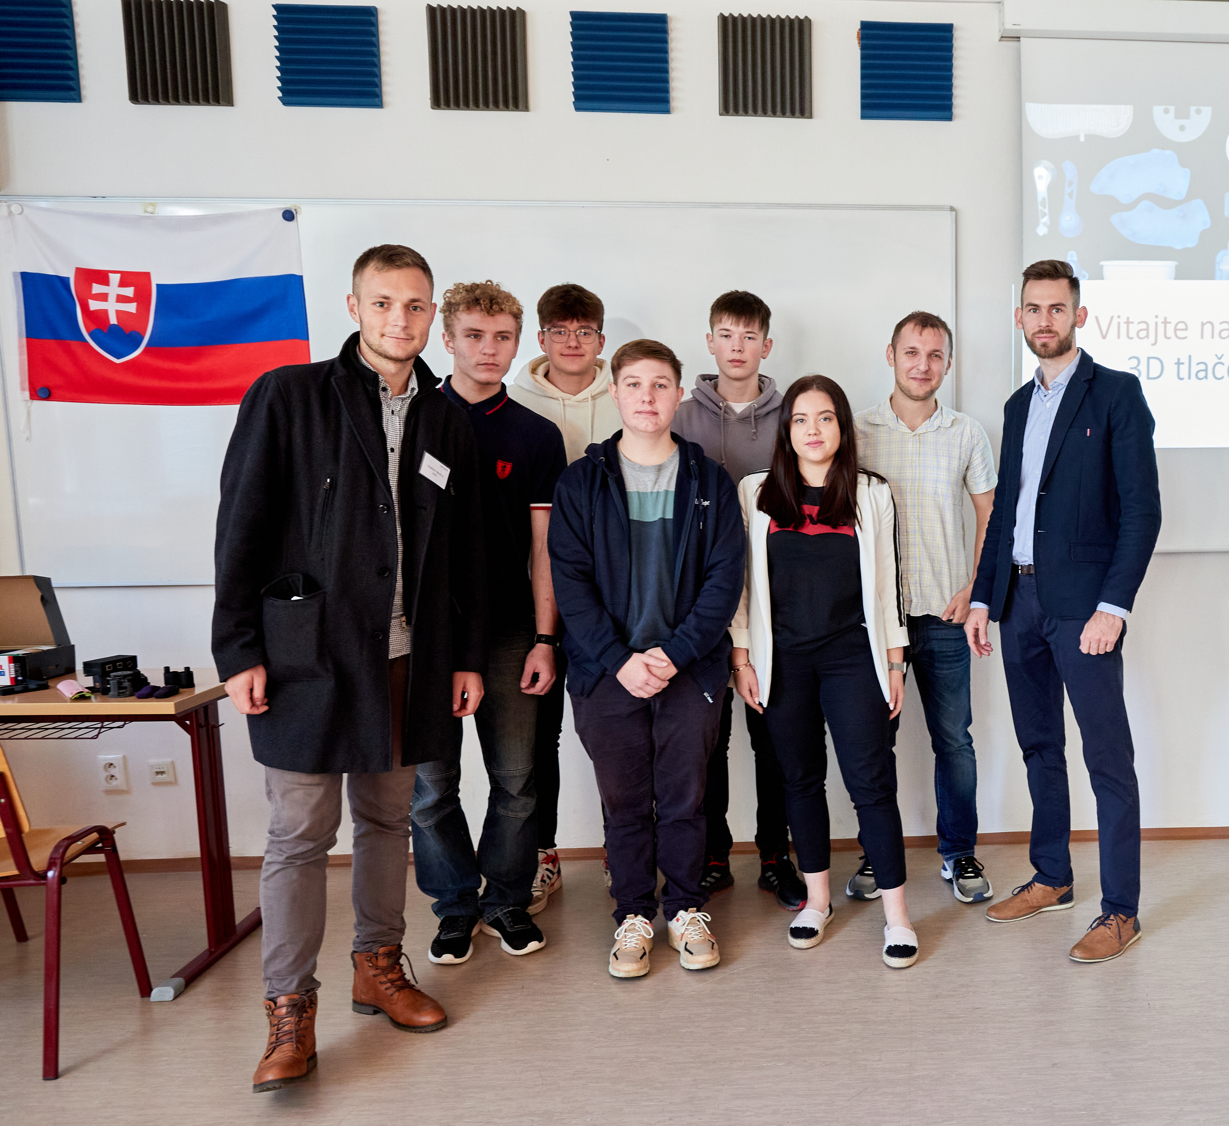
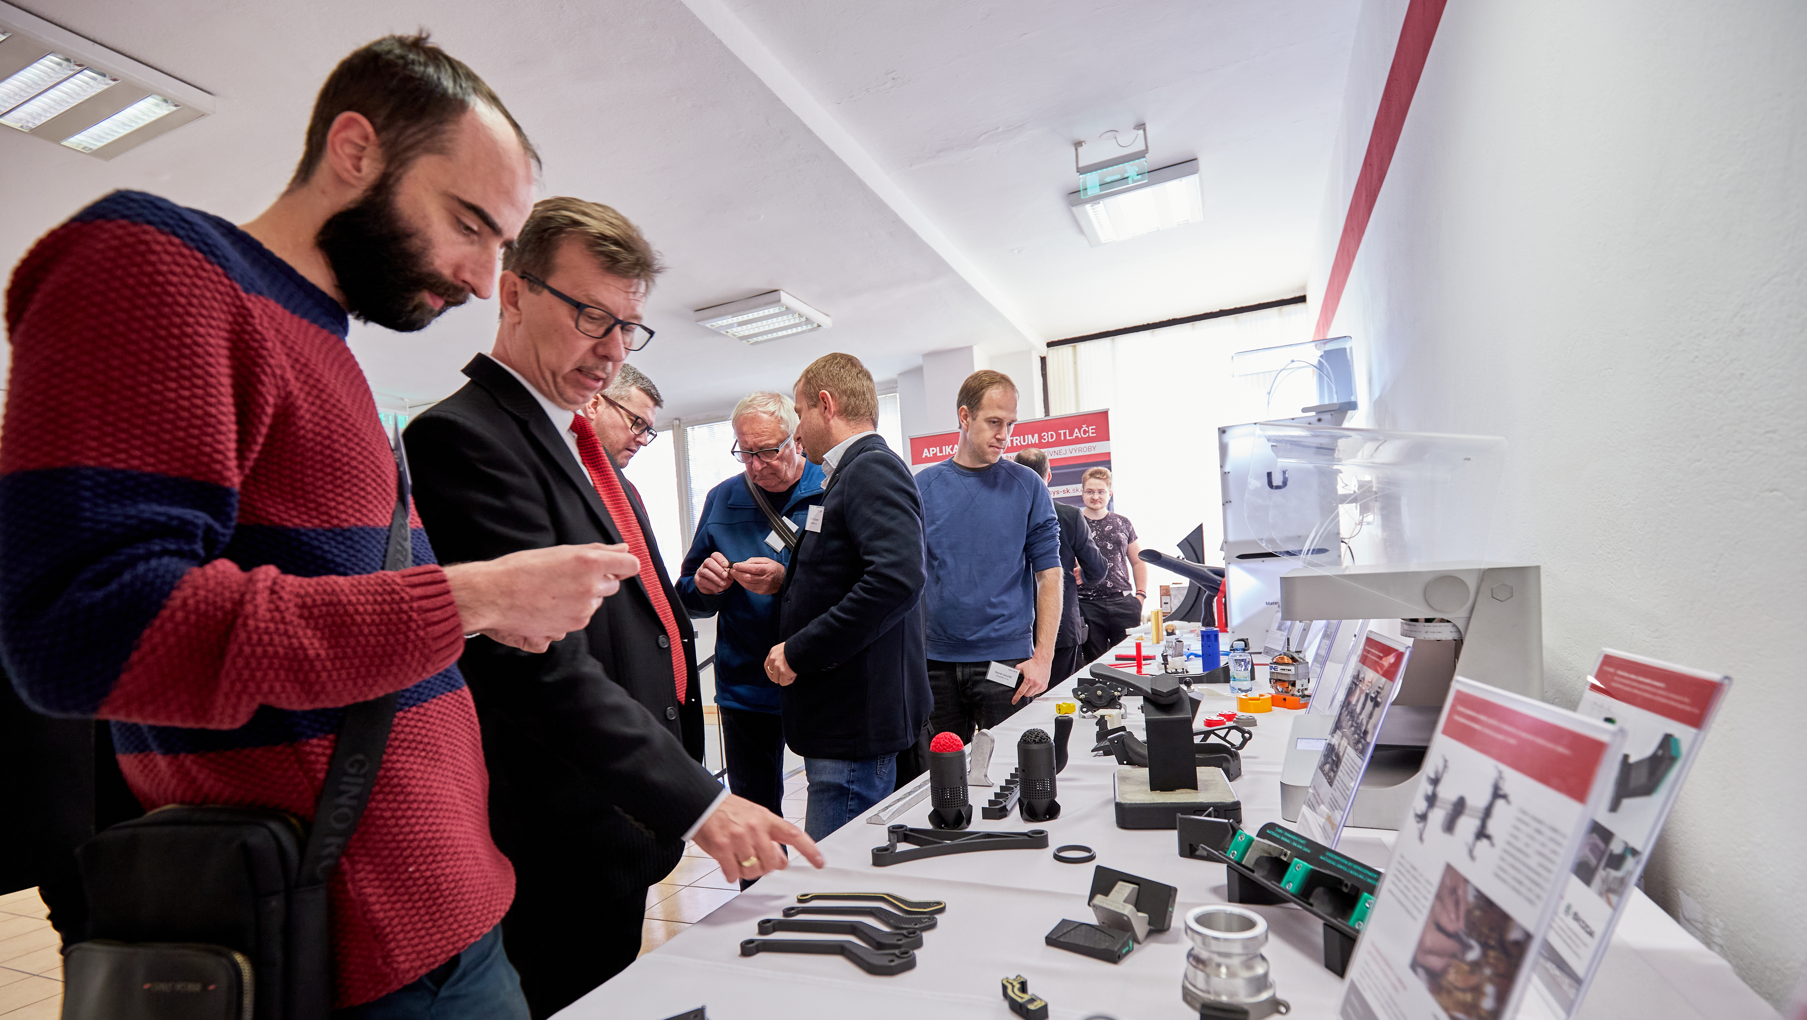
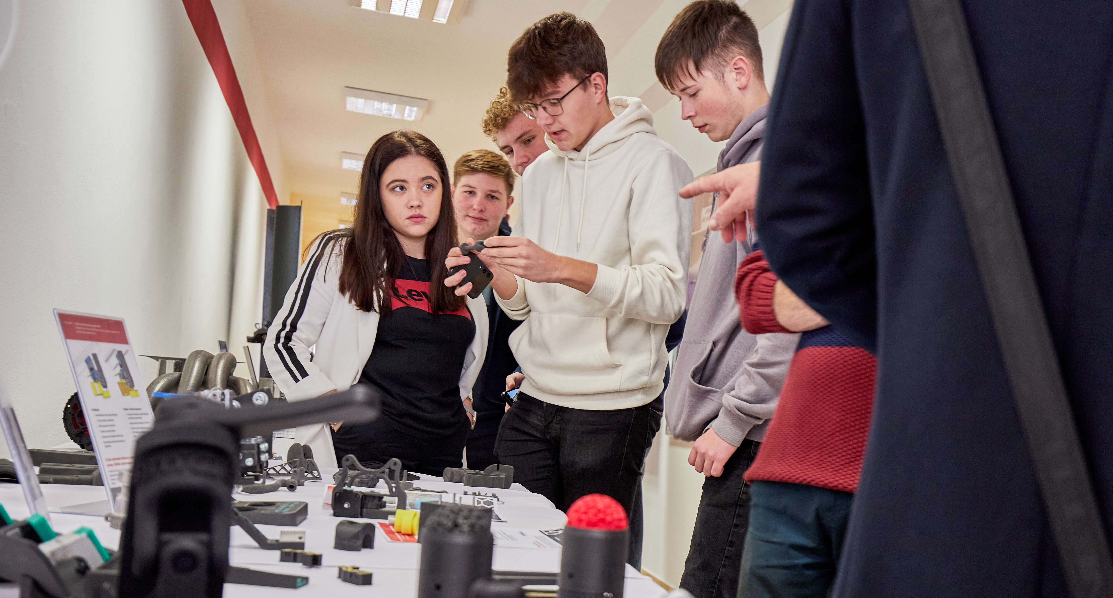
Activities
Information transfer (October - November 2022)
Introductory lectures and seminars about AM
Application of 3D printing in practice, composite materials and their use
(UNIZA & Admasys)

Slide 8
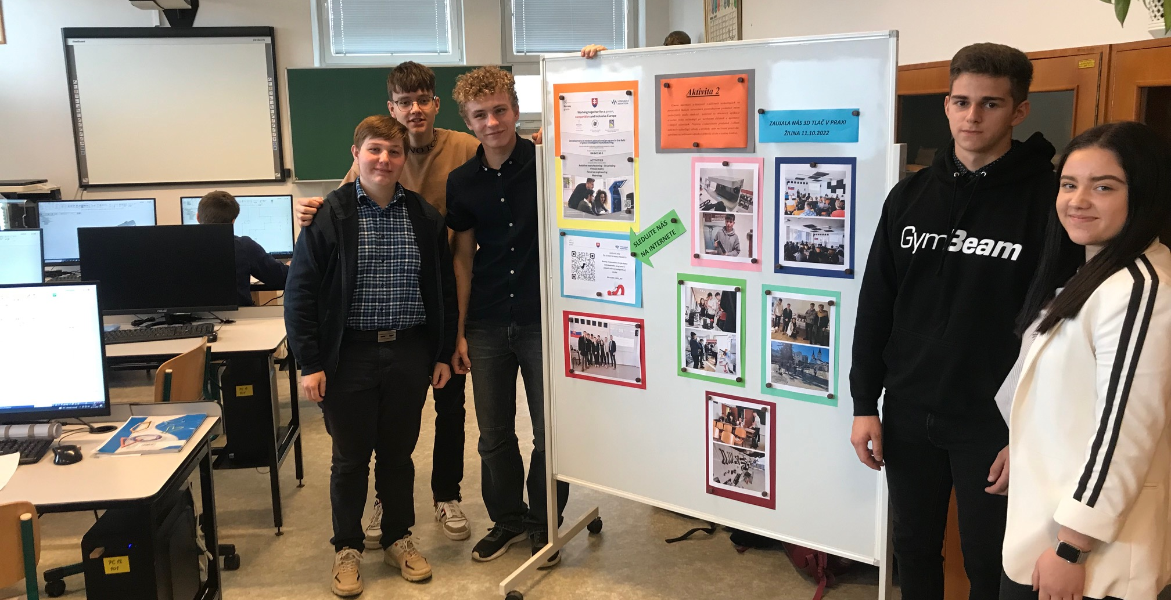
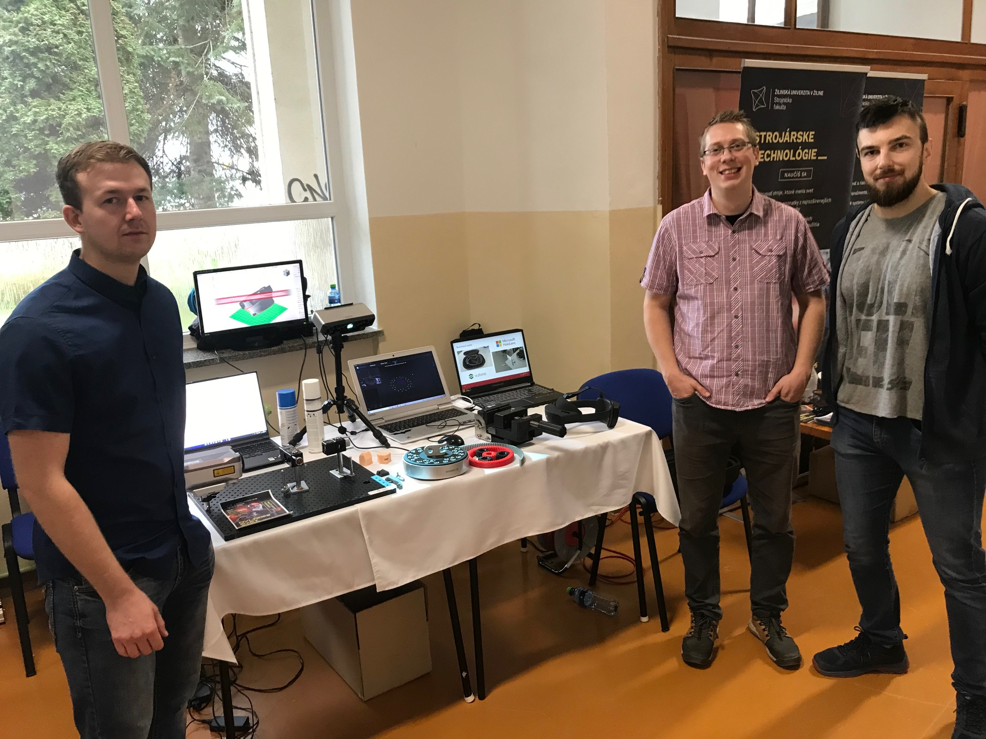
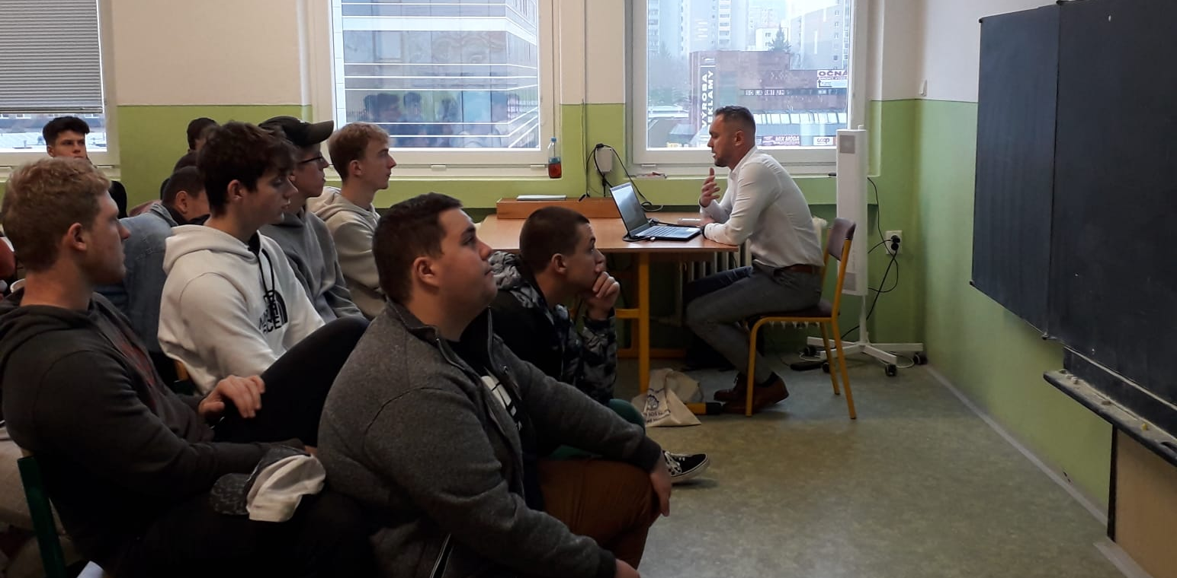
Activities
Information transfer (October - November 2022)
Introductory lectures and seminars about AM
Additive technologies from A to Z and their environmental impact
(SPŠ Dubnica nad Váhom)

Slide 9
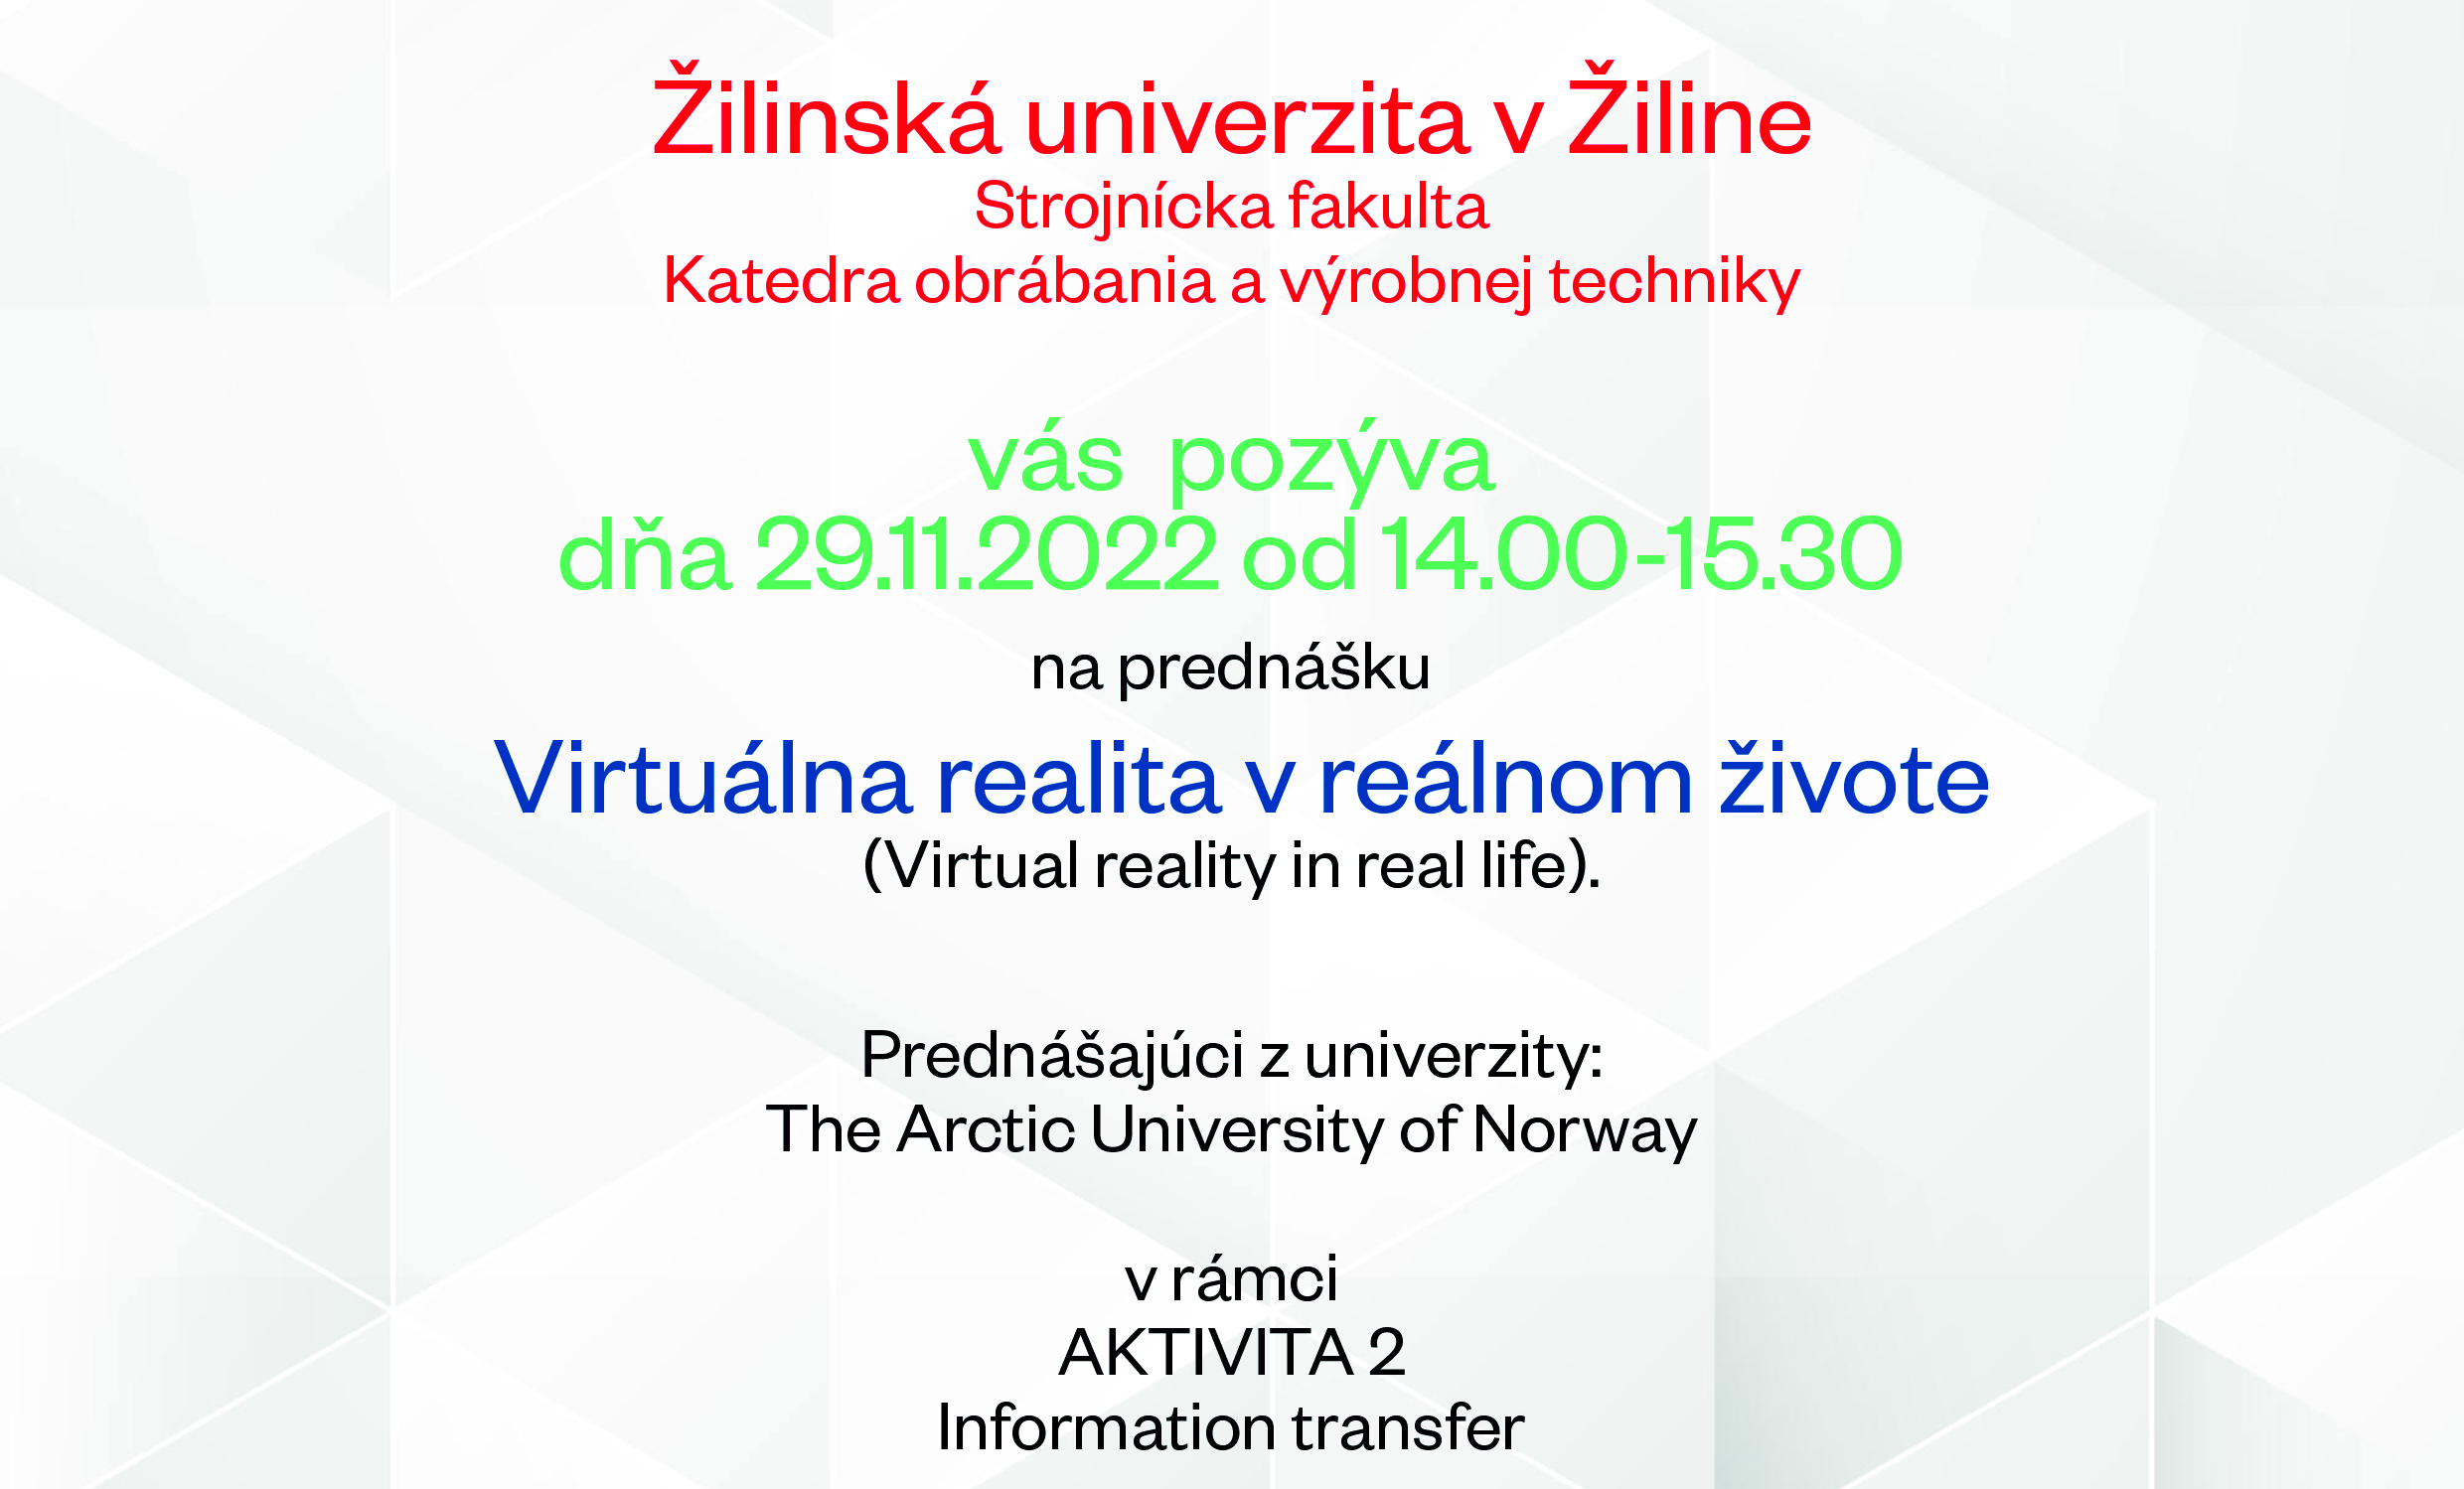
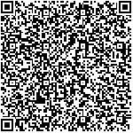
Activities
Information transfer (October - November 2022)
Introductory lectures and seminars about AM
Virtual reality in real life
(UiT Narvik)

Slide 10
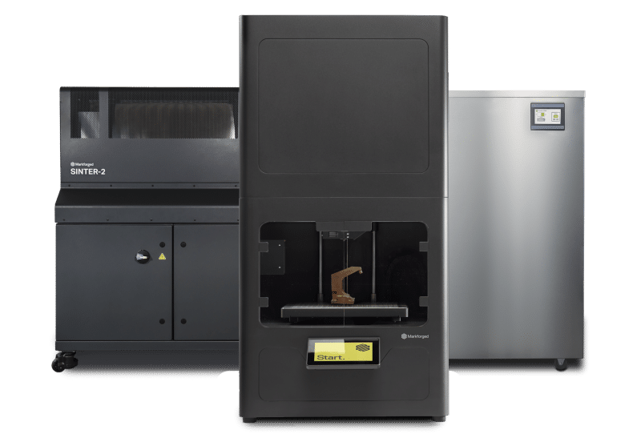
Activities
Workplace of modern education (December 2022 – May 2023)
Building of modern workplace with additive manufacturing
UNIZA
FDM/ FFF device
SPŠ Dubnica nad Váhom Composite Device
UiT Narvik
Metal device

Slide 11
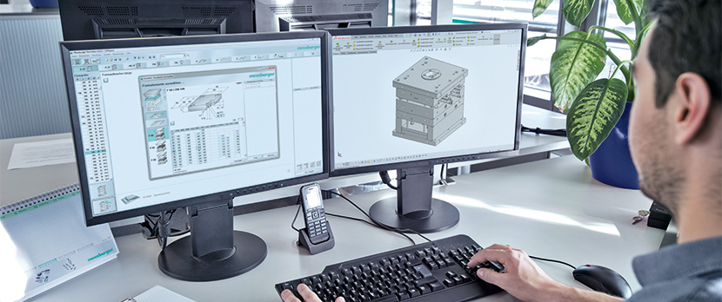
Activities
Modern classroom (January 2023 – August 2023)
Modern education supporting creativity
Design
Printing
Reverse engineering
Final metrology evaluation

Slide 12
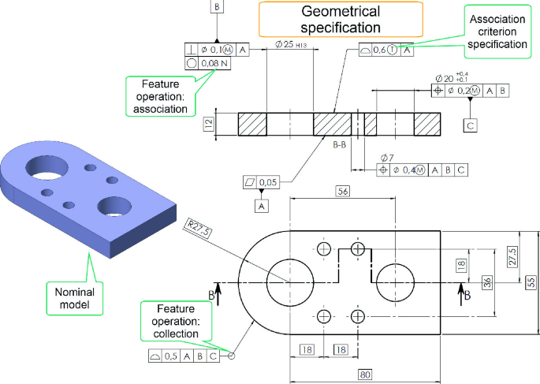
Activities
Geometric Product Specification (June – October 2023)
Technological/Metrological thinking of students

Slide 13
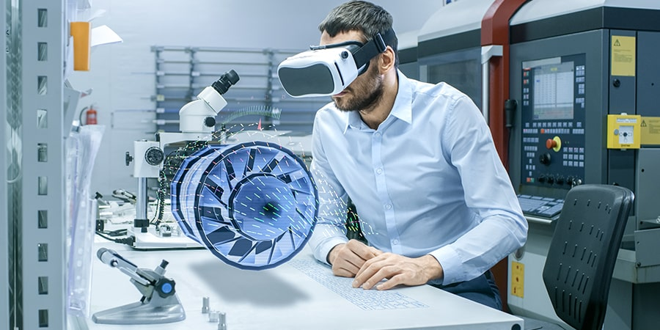
Activities
Virtual manufacturing (September 2023 – February 2024)
Virtual reality

Slide 14
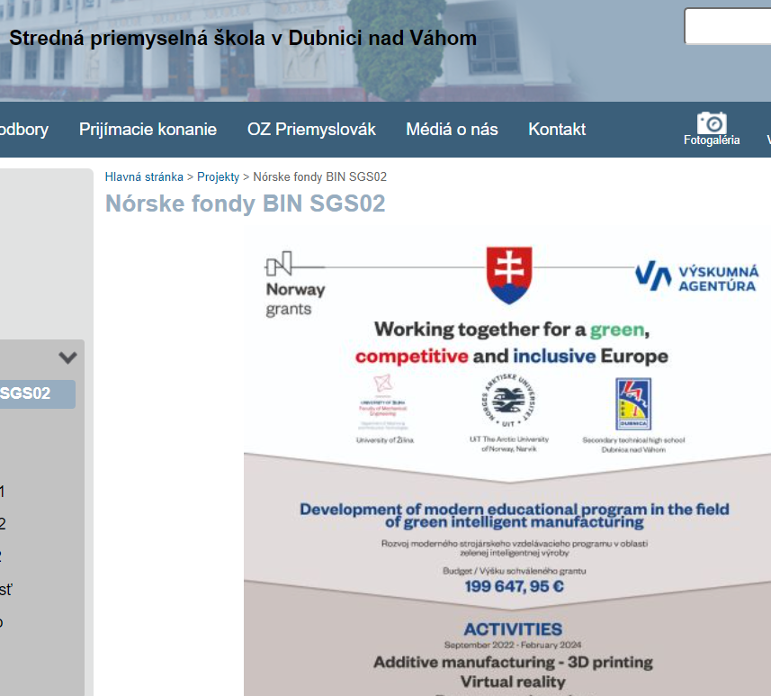
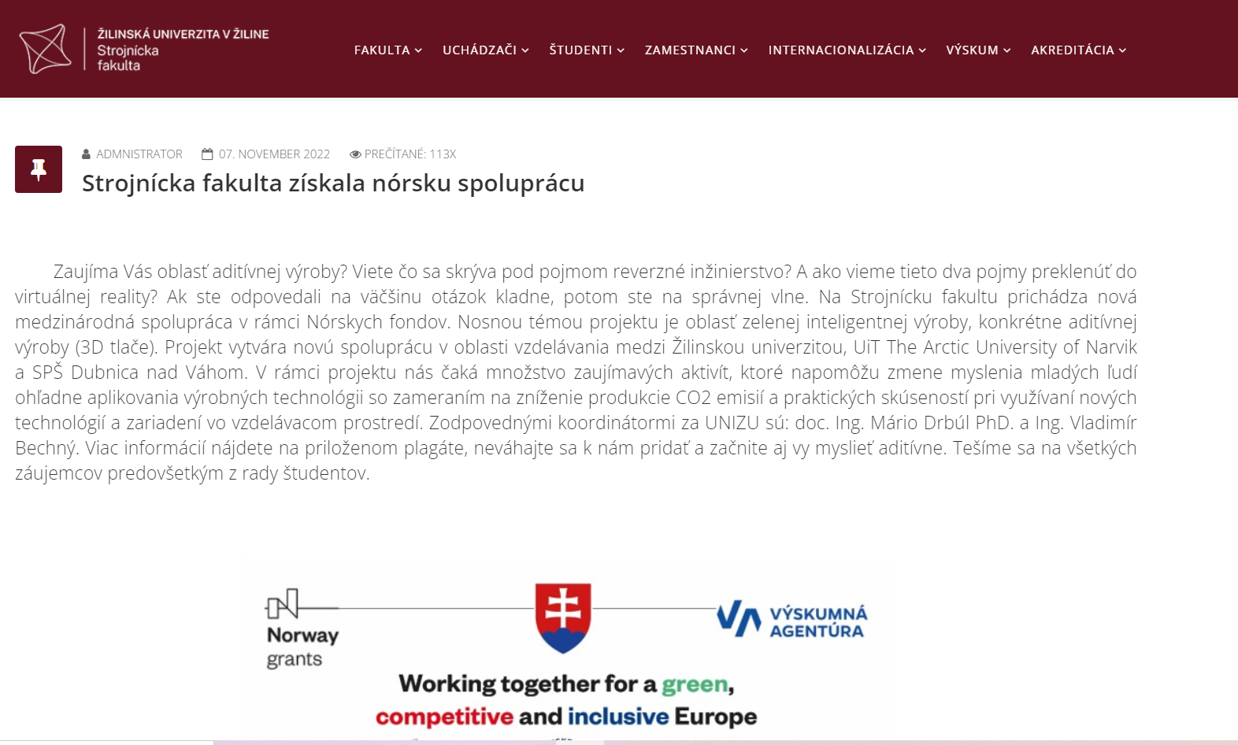

Activities
Dissemination of results (September 2022 – April 2024)
Ensuring project publicity
am.fstroj.uniza.sk

Slide 15
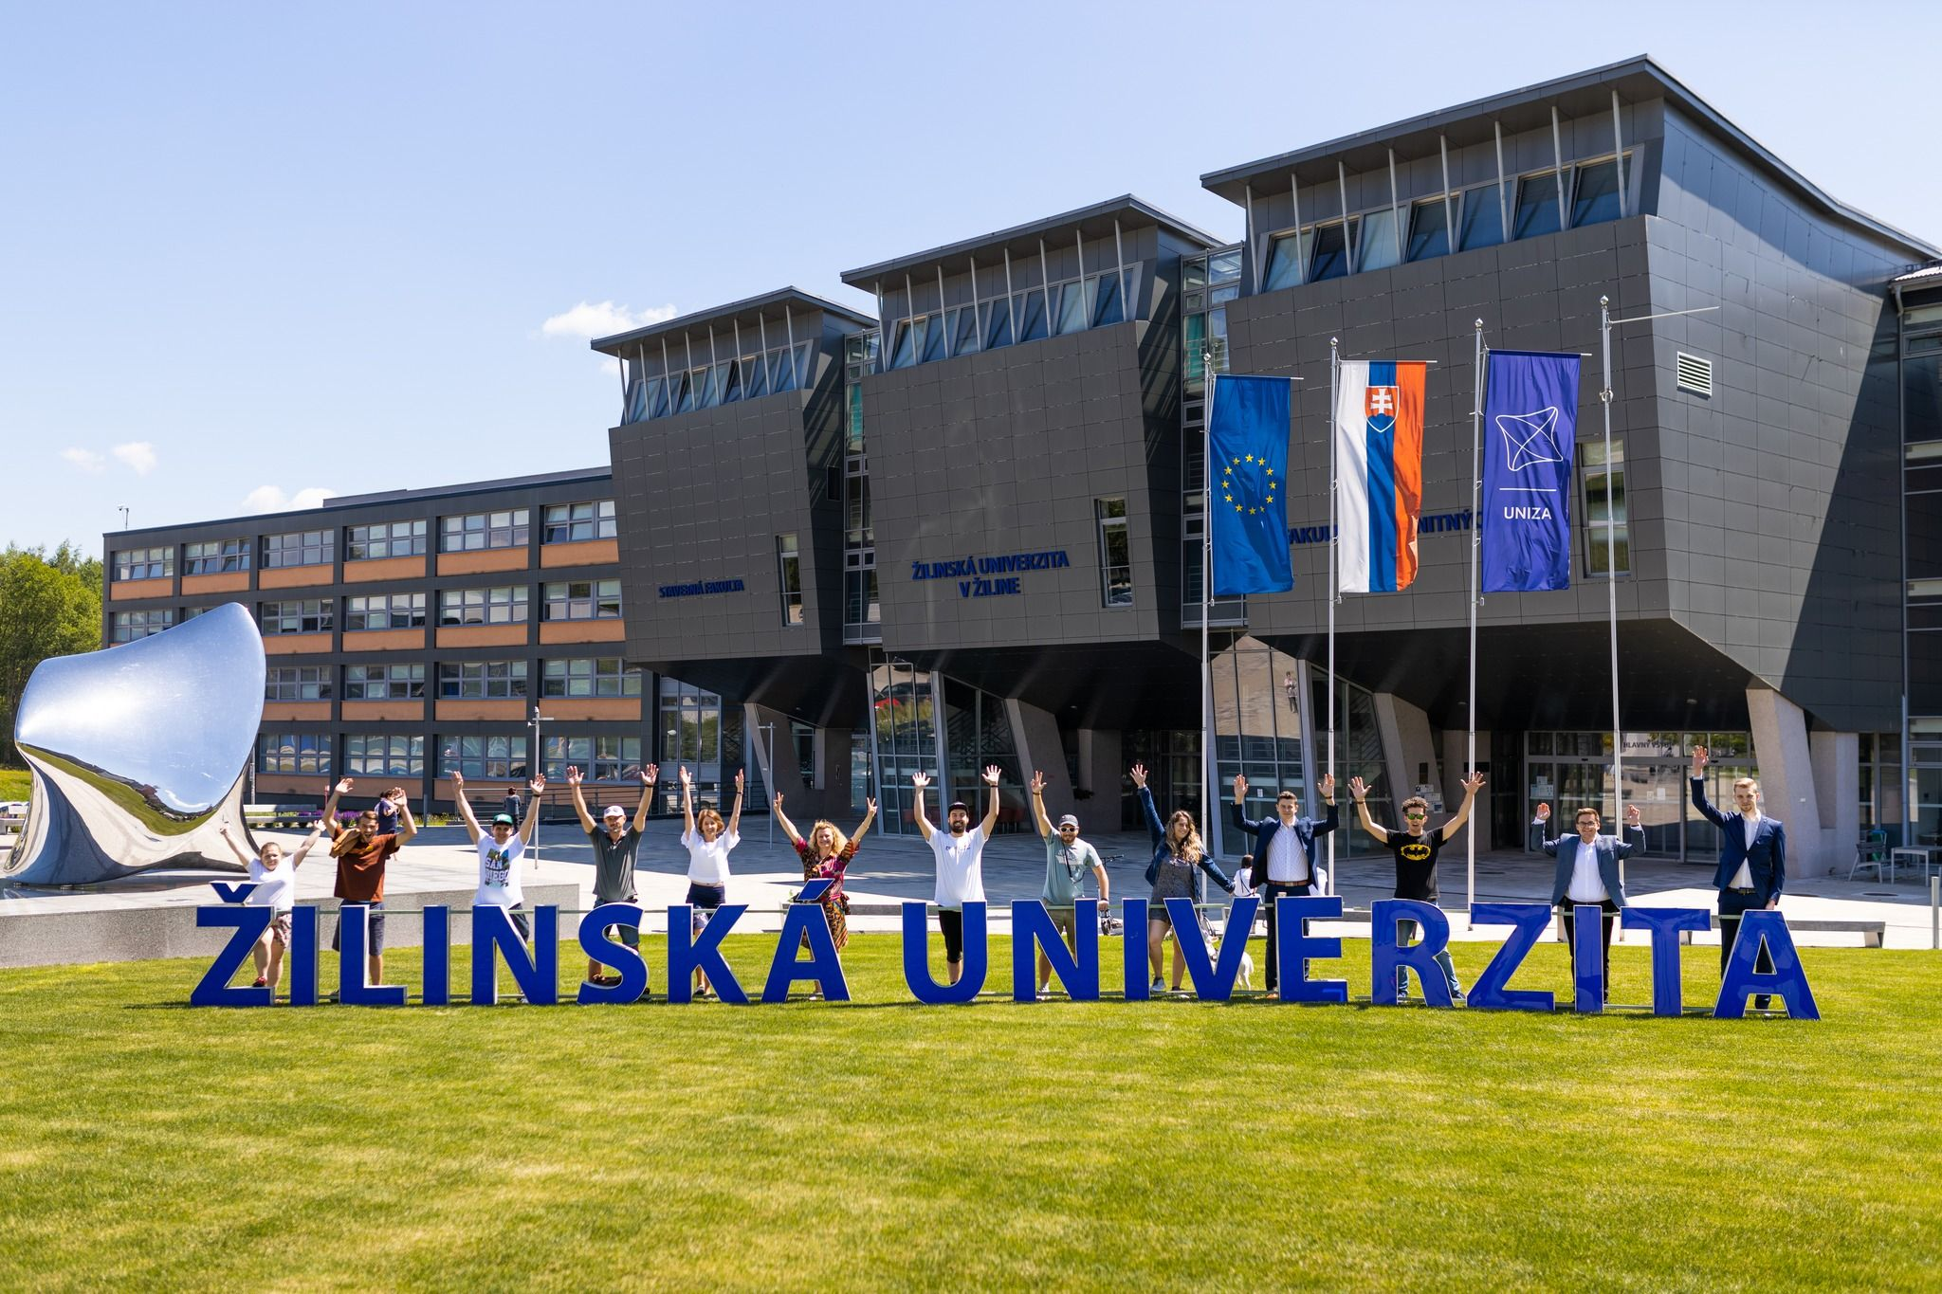
Activities
Final evaluation conference
Introductory lectures and seminars about AM

Slide 16


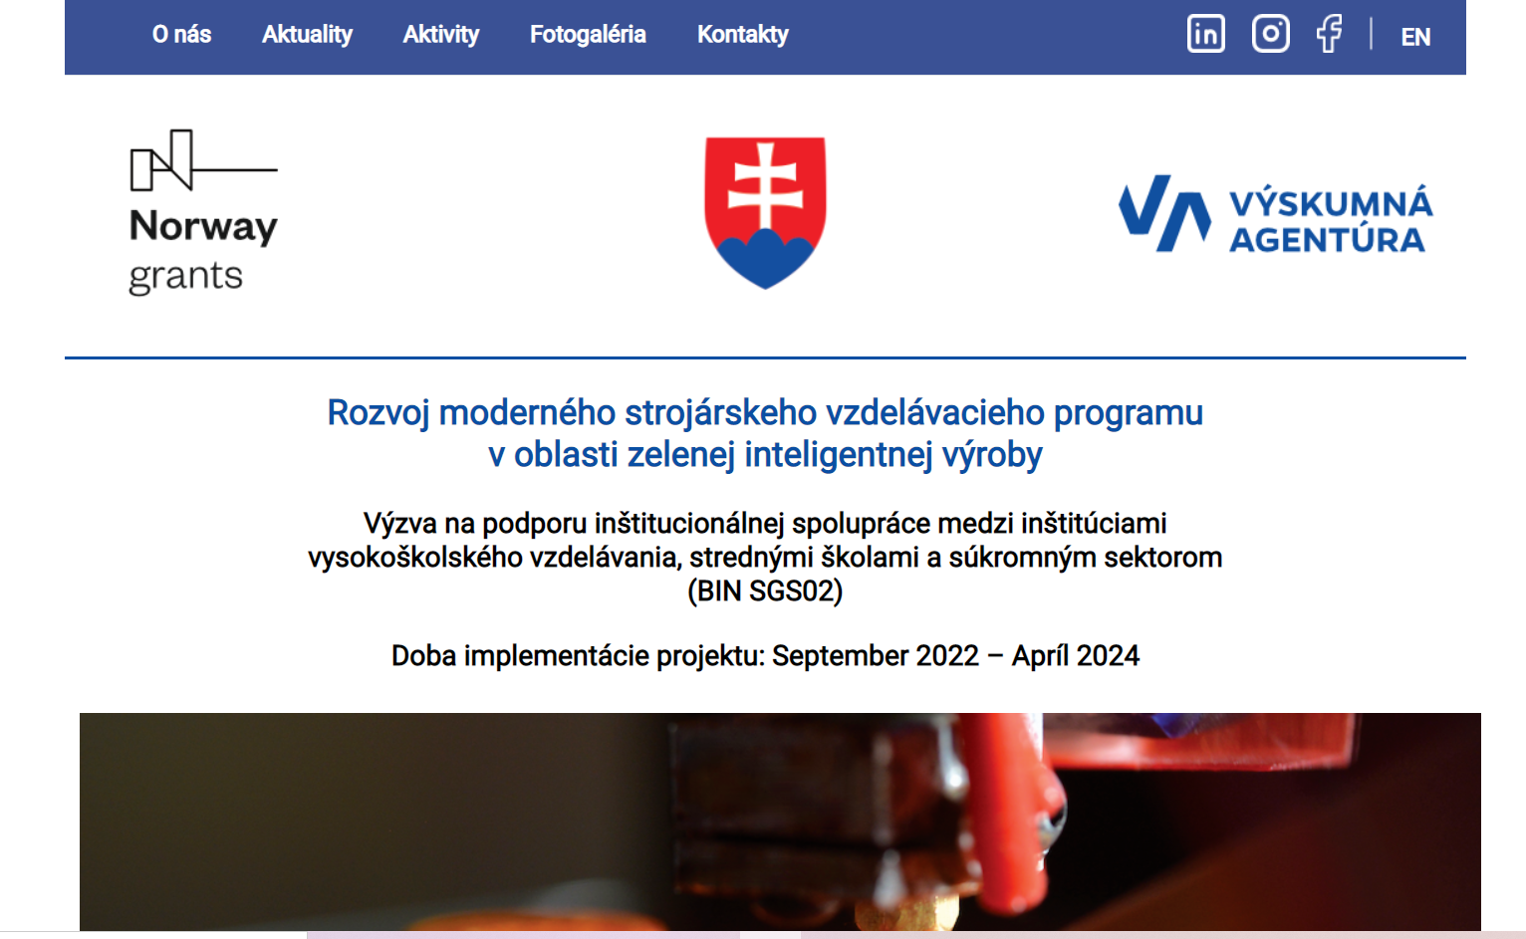
Website
Check our website for more information!!
am.fstroj.uniza.sk

Slide 17
Thank you for your attention ☺

Slide 18

Discussion
Questions

